Slide 1
SN2 REACTION
Reaction of Alkyl Halides
BY,
AKSHAYA K M

Slide 2
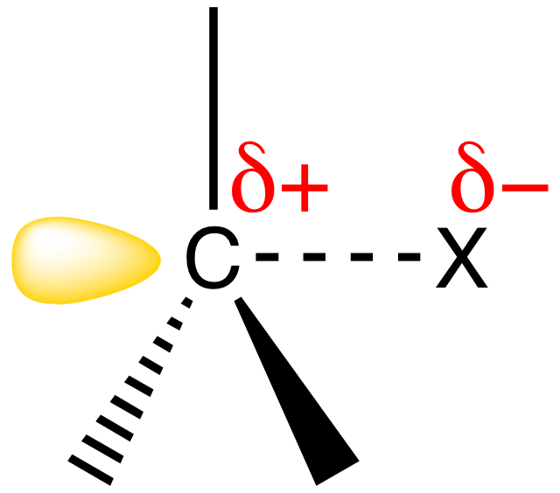
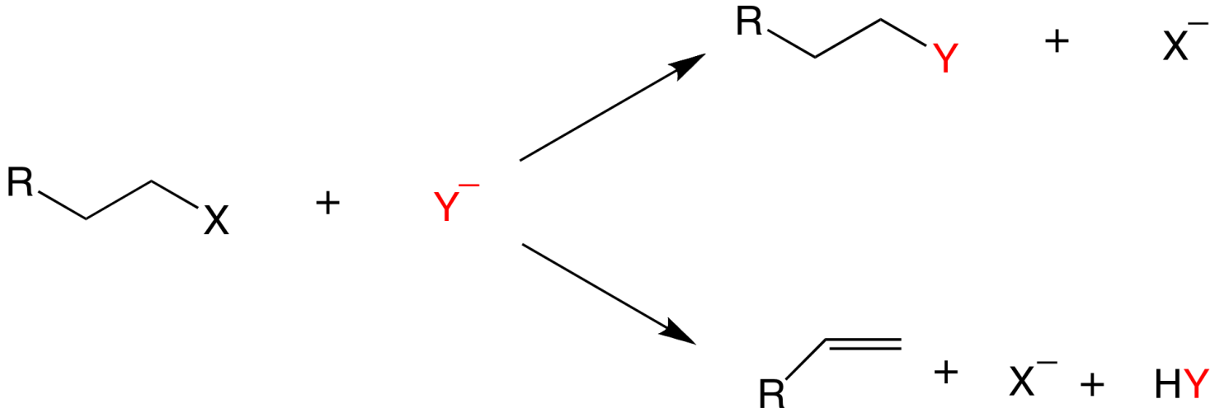
Organic compounds with an electronegative atom or an electron-withdrawing group bonded to a sp³ carbon undergo substitution or elimination reactions
Halide ions are good leaving groups. Substitution reaction on these compounds are easy and are used to get a wide variety of compounds
alkyl fluoride
alkyl chloride
alkyl bromide
alkyl iodide

Slide 3
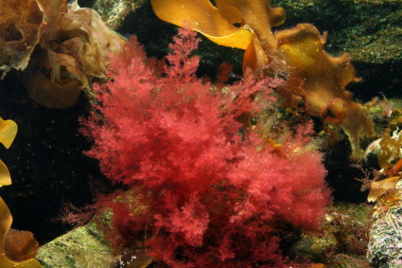
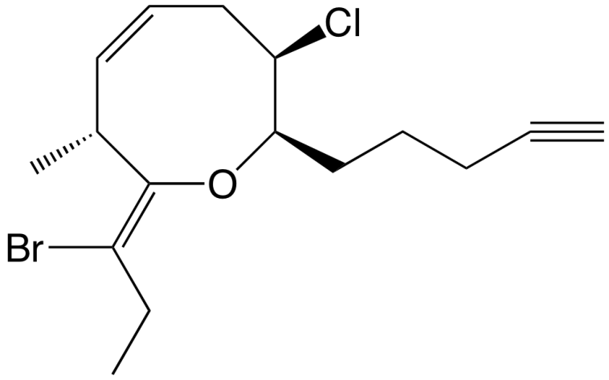
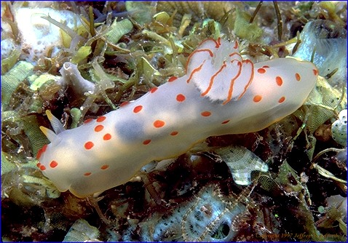
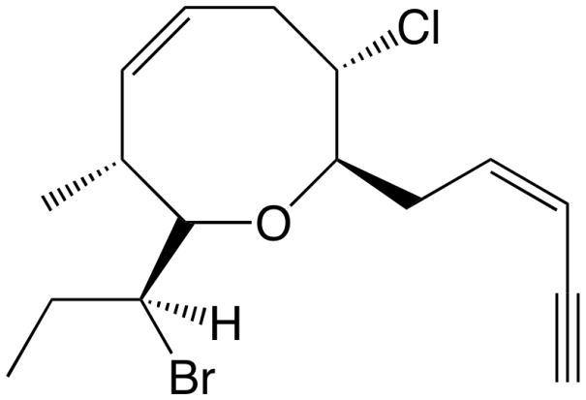
Alkyl Halides in Nature
Synthesized by red algae
red algae
Synthesized by sea hare
a sea hare

Slide 4
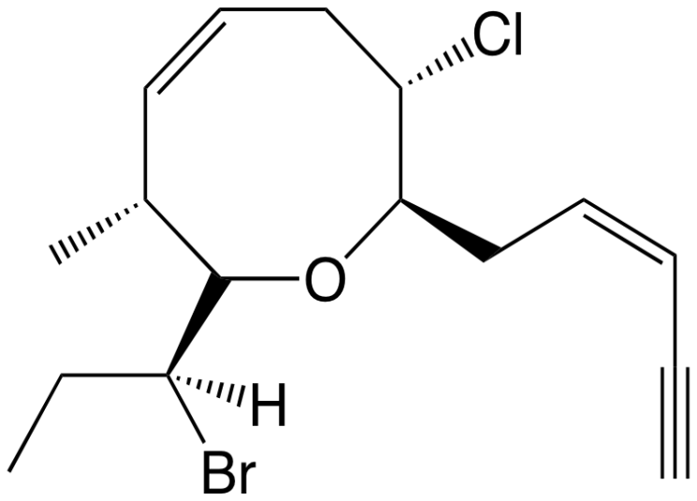
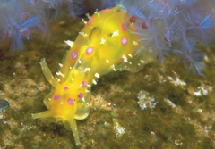
sea hare

Slide 5
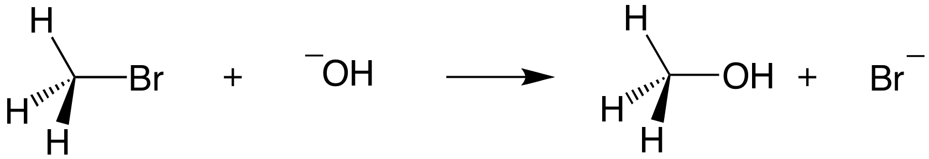
Substitution Reaction with Halides
(1)
(2)
bromomethane
methanol
If concentration of (1) is doubled, the rate of the reaction is doubled.
If concentration of (1) and (2) is doubled, the rate of the reaction quadruples.
If concentration of (2) is doubled, the rate of the reaction is doubled.

Slide 6
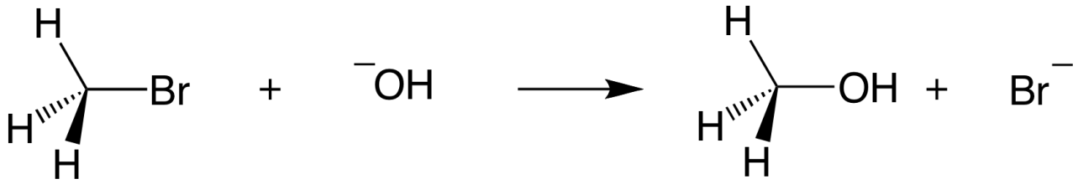
Substitution Reaction with Halides
bromomethane
methanol
Rate law:
rate = k [bromoethane][OH⁻]
this reaction is an example of a SN2 reaction.
S stands for substitution
N stands for nucleophilic
2 stands for bimolecular

Slide 7
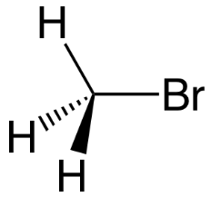
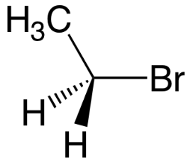
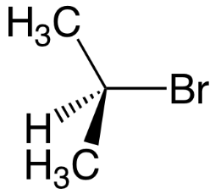
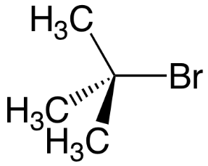
Mechanism of SN2 Reactions
Alkyl halide | Relative rate
 | 1200
 | 40
 | 1
 | ≈ 0
The rate of reaction depends on the concentrations of both reactants.
When the hydrogens of bromomethane are replaced with methyl groups the reaction rate slow down.
The reaction of an alkyl halide in which the halogen is bonded to an asymetric center leads to the formation of only one stereoisomer

Slide 8
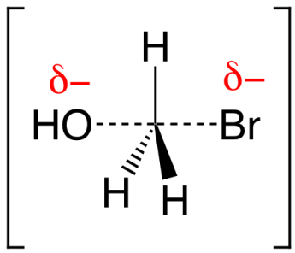
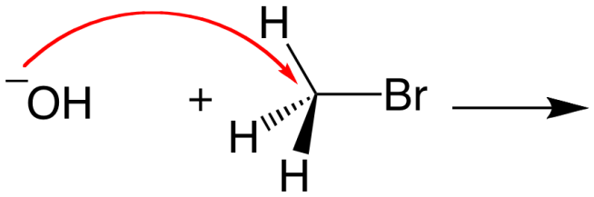
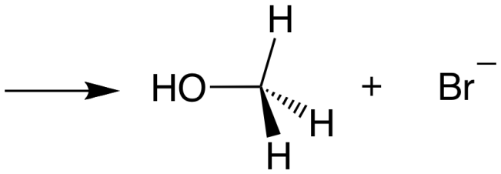
Mechanism of SN2 Reactions
Hughes and Ingold proposed the following mechanism:
Transition state
Increasing the concentration of either of the reactant makes their collision more probable.

Slide 9
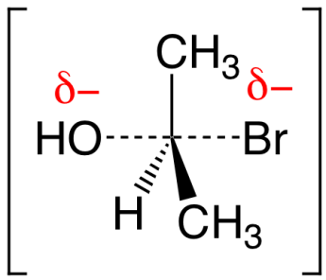
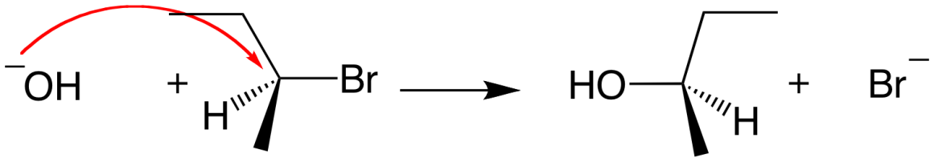
Mechanism of SN2 Reactions
Steric effect
activation
energy: ΔG₂
activation
energy: ΔG₁
Energy
reaction coordinate
reaction coordinate
Inversion of configuration
(R)-2-bromobutane
(S)-2-butanol

Slide 10
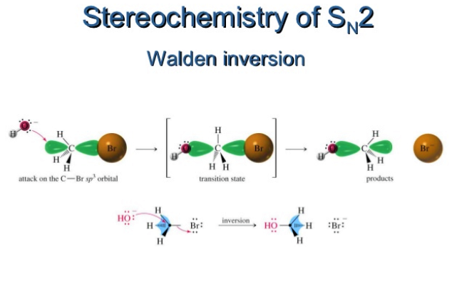

Slide 11
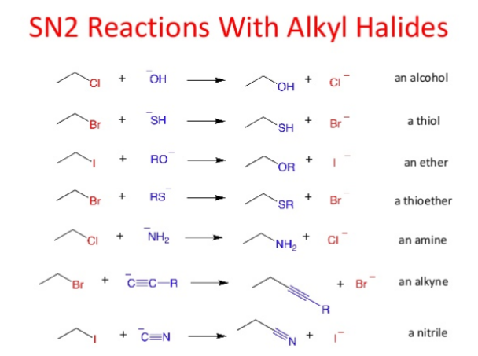

Slide 12
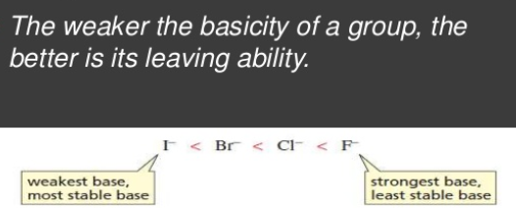
Factor Affecting SN2 Reactions
The leaving group

Slide 13
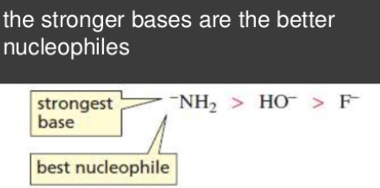
The nucleophile

Slide 14
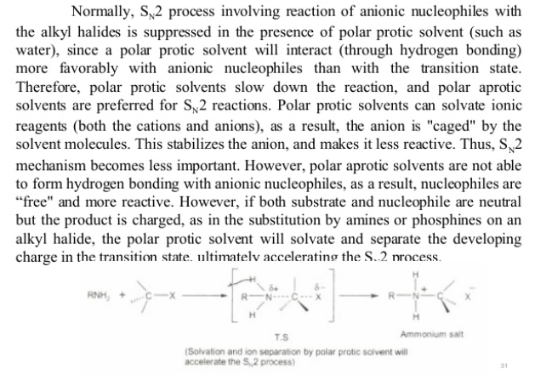
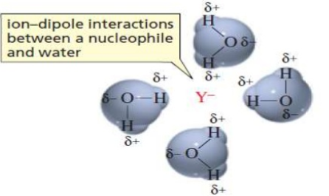
Effect of solvent

Slide 15
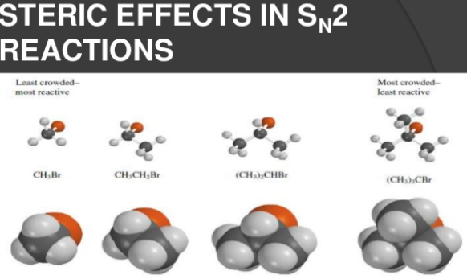

Slide 16
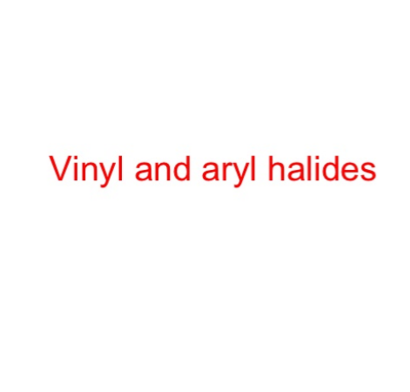

Slide 17
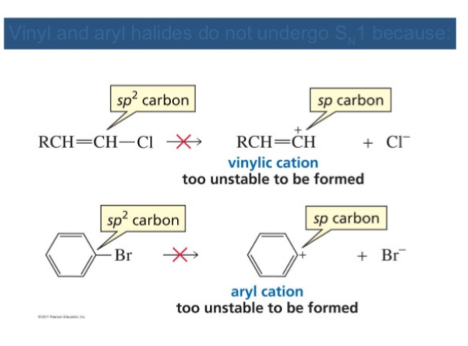

Slide 18
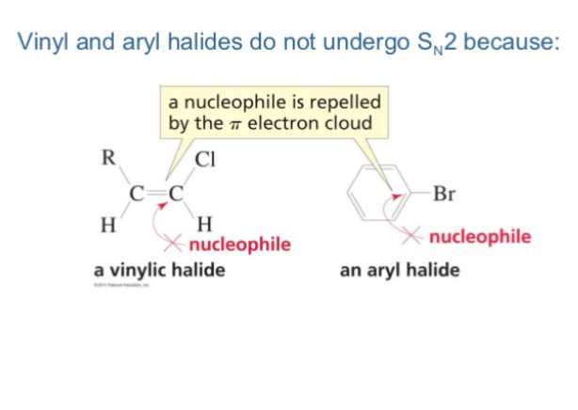

Slide 19
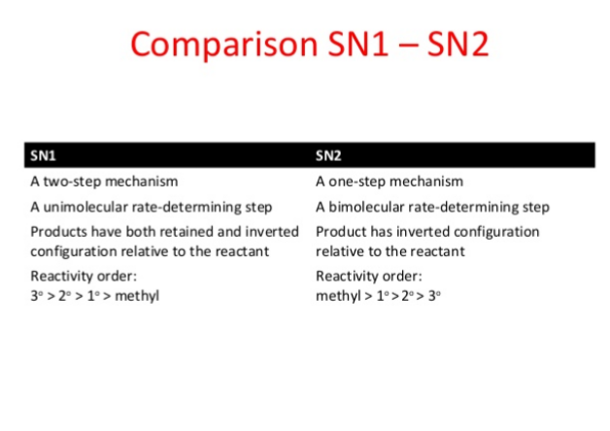

Slide 20
THANK YOU

