Slide 1
E Commerce
Jaiju R Babu
Asst Professor, Dept of Commerce And Business Administration
RSM SNDP Yogam College
Koyilandy

Slide 2
E-COMMERCE
E-commerce consists of the buying and selling of products or services over electronic systems such as the Internet and other computer networks.
Electronic commerce commonly known as e-commerce or e-commerce.

Slide 3
Electronic commerce was identified as the facilitation of commercial transactions electronically, using technology such as Electronic Data Interchange (EDI) and Electronic Funds Transfer (EFT).
What is EDI?
What is EFT?

Slide 4
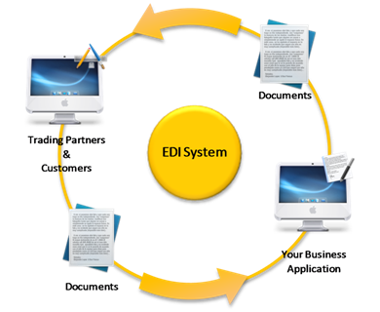
Electronic Data Interchange:
Electronic Funds Transfer:
EDI is the structured transmission of data between organizations by electronic means. It is used to transfer electronic documents or business data from one computer system to another computer system.
EFT is the electronic exchange or transfer of money from one account to another.

Slide 5
History of E-Commerce
The growth and acceptance of credit cards, automated teller machines (ATM) and telephone banking in the 1980s were also forms of electronic commerce.
Another form of E-Commerce was the airline reservation system, for example Sabre in the USA and Travicom in the UK.

Slide 6
Advantages of E-commerce
Faster buying/selling procedure, as well as easy to find products.
Buying/selling 24/7.
Low operational costs and better quality of services.
Easy to start and manage a business.
No need of physical company set-ups.
Customers can easily select products from different providers without moving around physically.

Slide 7
Disadvantages of E-commerce
There is no guarantee of product quality.
There are many hackers who look for opportunities, and thus an ecommerce site, service, payment gateways, all are always prone to attack.
Insufficient telecommunication bandwidth

Slide 8
Types of E-comerce
B2B (Business-to-Business)
B2C (Business-to-Consumer)
C2B (Consumer-to-Business)
C2C (Consumer-to-Consumer)

Slide 9
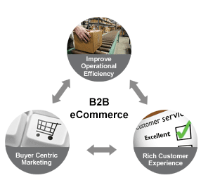
1) BUSINESS TO BUSINESS (B2B)
B2B can be open to all interested parties or limited to specific, pre-qualified participants (private electronic market).
Companies doing business with each other such as manufacturers selling to distributors and wholesalers selling to retailers.

Slide 10
2) BUSINESS TO CONSUMER
(B2C)
Businesses selling to the general public typically through catalogs utilizing shopping cart software.
B2C is the indirect trade between the company and consumers.
It provides direct selling through online.
If you want to sell goods and services to customer so that anybody can purchase any products directly from supplier’s website.

Slide 11
3) CONSUMER TO BUSINESS (C2B)
A consumer posts his project with a set budget online and within hours companies review the consumer's requirements and bid on the project.
The consumer reviews the bids and selects the company that will complete the project.
C2B empowers consumers around the world by providing the meeting ground and platform for such transactions.

Slide 12
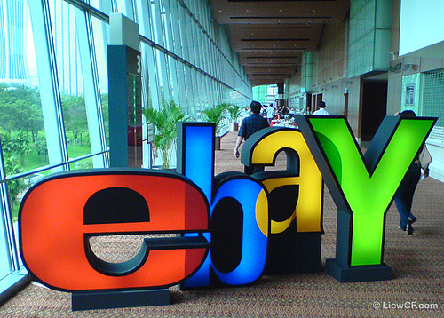
4)CONSUMER TO CONSUMER (C2C)
It facilitates the online transaction of goods or services between two people.
Though there is no visible intermediary involved but the parties cannot carry out the transactions without the platform which is provided by the online market maker such as eBay.

Slide 13
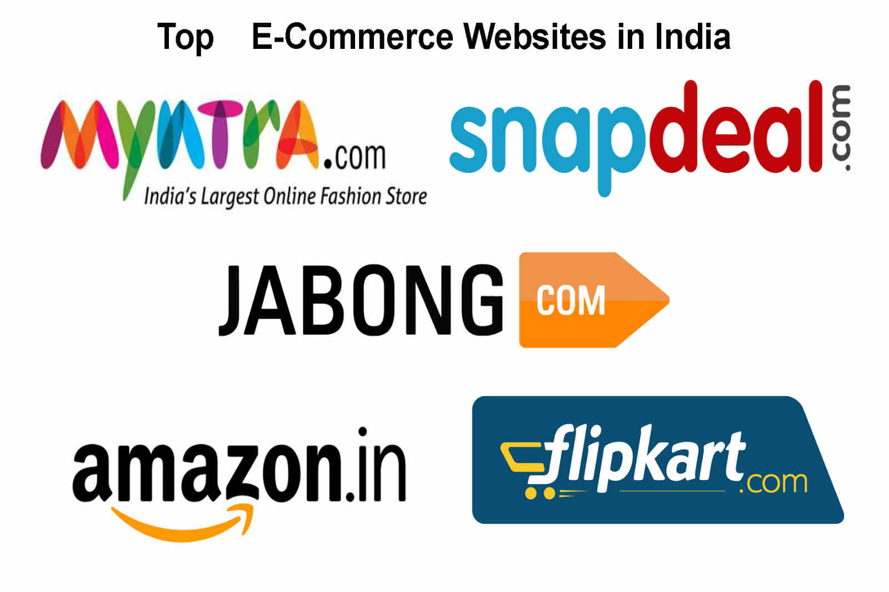

Slide 14
THANK YOU

