Slide 1
THEORY OF CONSUMER BEHAVIOUR
ASWATHI P K
Assistant Professor,
PG department of Commerce

Slide 2
DEMAND
A desire which is backed by willingness to pay and ability to pay is called demand.
LAW OF DEMAND
When the price of a commodity falls the quantity demanded increases and when its price increases its quantity demanded decreases. Thus, there is a inverse relationship between the price and its quantity demanded. This relationship is known as Law of Demand.

Slide 3
Utility
It is generally defined as the capacity or power of a commodity to satisfy a want. Utility determines demand for a commodity.
Total Utility
It is the sum of the utilities obtained from consuming all the units of a commodity. Total utility is measured in units called utils.
Eg: If an individual consume only one unit of commodity the total utility will be utility derived from the consumption of that unit.
Marginal Utility
It refers to the utility derived from the last unit of a commodity consumed.

Slide 4
CARDINAL UTILITY APPROACH ( CARDINAL ANALYSIS)
Cardinal utility approach is also known as neo-classical utility theory or Marshallian utility theory.
The Cardinal utility theory states that utility is measurable just as height, weight, length, temperature, etc.
According to Cardinal utility theory utility is measurable cardinally or quantitatively . It means utility can be measured in cardinal numbers like 1,2,3 and so on.
Utility can be measured in utils.
Assumptions of Cardinal Utility Theory
1.Utility is measurable in numerical terms.
2.Every consumer is rational.

Slide 5
3. Every rational consumer intends to maximise his or her satisfaction from his or her money income.
4.The consumer has limited income to spend on the goods and services he or she chooses to consume.
5.Utility gained from the successive units of a commodity goes on diminishing.
6.The marginal utility of money remains constant.
7.The utilities are independent(i.e., the commodities are neither substitutes nor complements)
8.Utility derived from various goods and services consumed by a consumer can be added together to obtain the total utility.

Slide 6
Defects or Limitations of Cardinal Utility Approach
1.Utility is subjective.
2.The cardinal approach assumes that the utility depends upon that commodity alone. This assumption is not correct.
3.The utility analysis is unable to explain the existence of the Giffen goods.
4.The assumption that man is rational is not correct.
5.The cardinal approach does not study income effect, substitution effect and price effect.

Slide 7
Consumer’s Equilibrium in terms of the Utility Analysis
The position of maximum satisfaction implies consumer’s equilibrium position .
This can be determined with the help of three fundamental laws-
1.Law of diminishing marginal utility ( Single commodity)
2. Law of equi- marginal utility (two or more commodities)
3. Concept of Consumer Surplus

Slide 8
Law of Diminishing Marginal Utility
Gossen was the first economist to present the law of diminishing marginal utility.
This law explains human behaviour( consumer behaviour) in relation to the consumption of a commodity.
Law of diminishing marginal utility states that as a consumer consumes more and more units of a commodity, each successive unit gives him lesser and lesser satisfaction.
The law states that from the first unit, an individual gets the greatest satisfaction.

Slide 9
For example,
The following table shows how the marginal utility goes on diminishing when we consume increasing number of mangoes.
No. of Mangoes | Total Utility | Marginal Utility
1 | 5 | 5
2 | 9 | 4
3 | 12 | 3
4 | 14 | 2
5 | 15 | 1
6 | 15 | 0
7 | 14 | -1

Slide 10
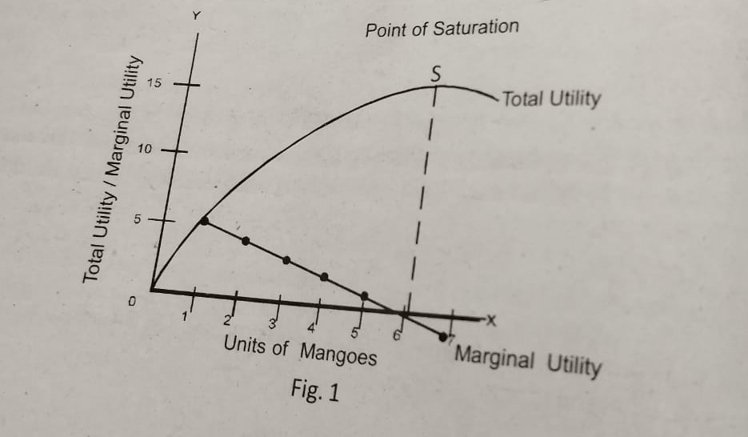
The law of diminishing marginal utility can be described through the following diagram:

Slide 11
Relation Between Marginal Utility and Total Utility
The relation between marginal utility and total utility as indicated by the above chart and graph can be stated as follows:
Marginal Utility | Total Utility
Declines Reaches Zero Becomes Negative | Increases but at a diminishing rate. Reaches Maximum Declines from the maximum

Slide 12
THANK YOU

