Slide 1
FILM STUDIES
TERMINOLOGIES OF FILM MAKING
NANDHITHA U M
Assistant professor
DEPARTMENT OF ENGLISH

Slide 2
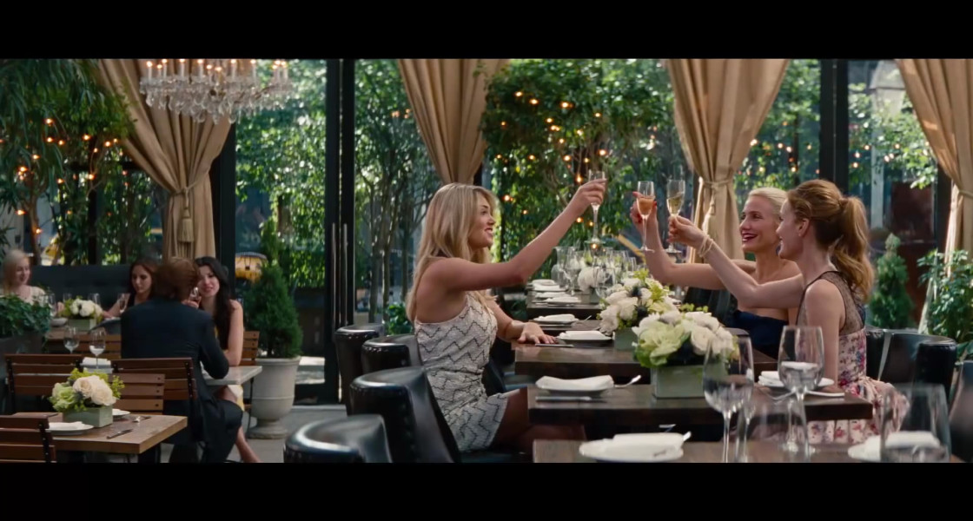
Part 1- Production
Mise en scene: It is a French word meaning, “placing on the stage”. The etymology of the word can be traced to theatre as the word was used to denote stage setting during a play. In cinema, mise en scene means, “put on the scene”. In other words, it is the arrangement of a movie frame, which results in the creation of meaningful images.
The term denotes all that appears before the camera.
Associated with the French New Wave movement.
Mise en scene is a combination of a number of components
including setting, properties, costume, lighting and acting

Slide 3
Components of Mise en scene
Setting: Setting is the most vital part in mise en scene. Theme of the scene and the mood to be conveyed to the audience are decided during the actualization of setting.
Setting helps in understanding the period of the film.
Builds a connection between the characters and the locale.
Properties: Props help in enhancing the impact of a particular scene.
Objects that are apt for a scene are placed in the frame.
It also helps the characters to convey their emotions properly, which could make a scene more communicative with the audience.

Slide 4
Costume: Costume helps to set the mood of a character and gives hints about his/her situation and status as well. The period of the movie can be understood with the use of proper costumes. It can also effectively indicate the cultural specialties of certain characters. Lighting: Proper lighting is necessary to get the mood of the scene across to the audience. Bright or dull lighting can add flavour to the frames. Even the characters emotions can be reflected by the use of light.
Acting: Actors performance holds key to the effectiveness of a scene. Mise en scene’s impact is decided by the expressions of the character. It makes the scene impactful.
Other essential factors in designing a character such as makeup and hairstyle can also be included as part of mise en scene.
The German Expressionist movie The Cabinet of Dr. Caligari directed by Robert Wiene is renowned for the creative application of mise en scene. Citizen Kane directed by Orson Wells is also noted for the effective use of the technique.

Slide 5
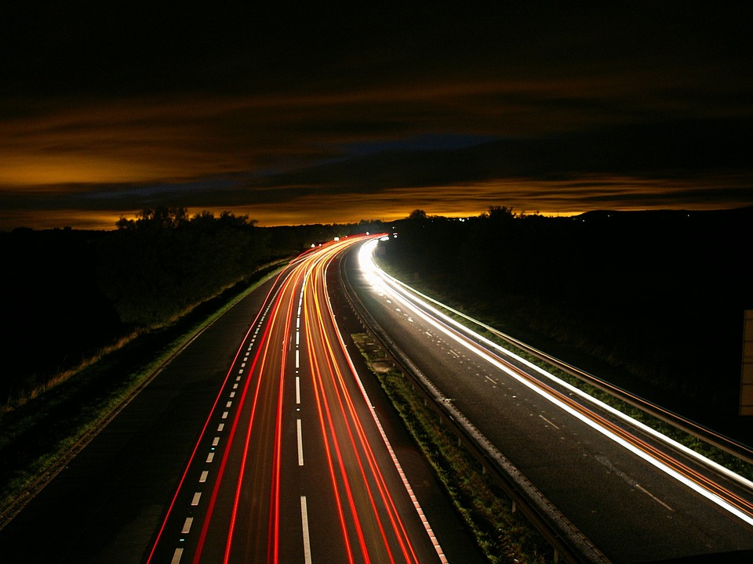
Types of shots in film
Long Shot: Long Shot, is also known as wide shot, is used in films as an establishing shot. Both the
object and its surroundings are given equal importance in a long shot. Multiple
characters could appear in long shots, which could give a clear idea about the milieu to
the audience. Audience might feel isolated from the location of the narrative as a clear
distance is built between the action and the spectators.
Extreme long shot: Variant of the long shot, the camera is placed far away from the location and people
in the scene will not be recognizable to the viewers. Rather than the people, context
of the scene is given importance here.

Slide 6
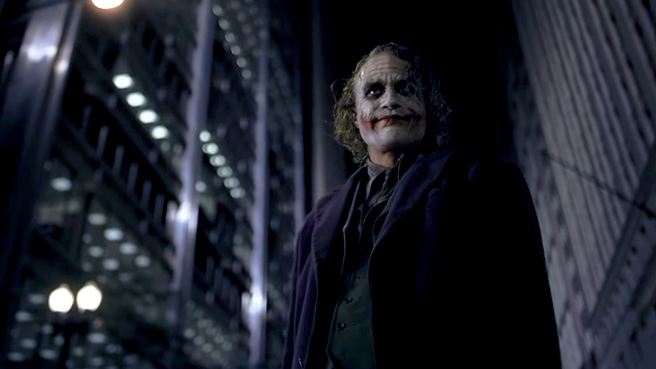
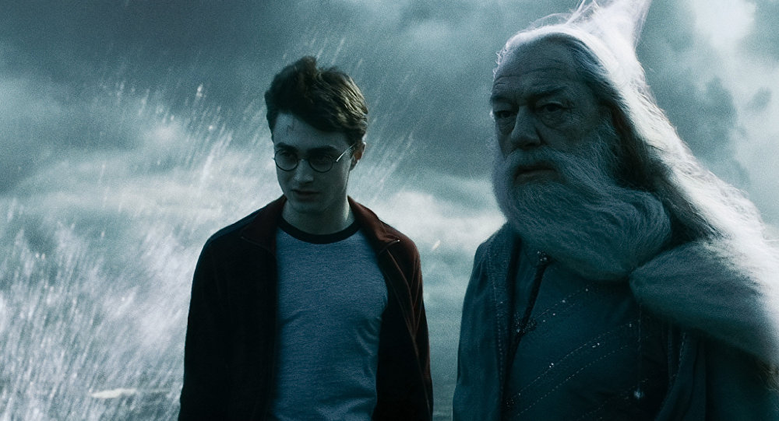
2. Medium Shot : Also known as mid –shot or waist shot, medium shot captures the object from a medium
distance. A person’s head to waist is shot using this technique. Background is visible
partially so that hints can be provided about the place of action. More than one person
can be included in such a shot and rather than focusing on the facial expression,
movement of bodies is given due significance. Also used to focus on a characters body
language and costumes.
This Photo by Unknown Author is licensed under CC BY-NC-ND
This Photo by Unknown Author is licensed under CC BY-SA

Slide 7
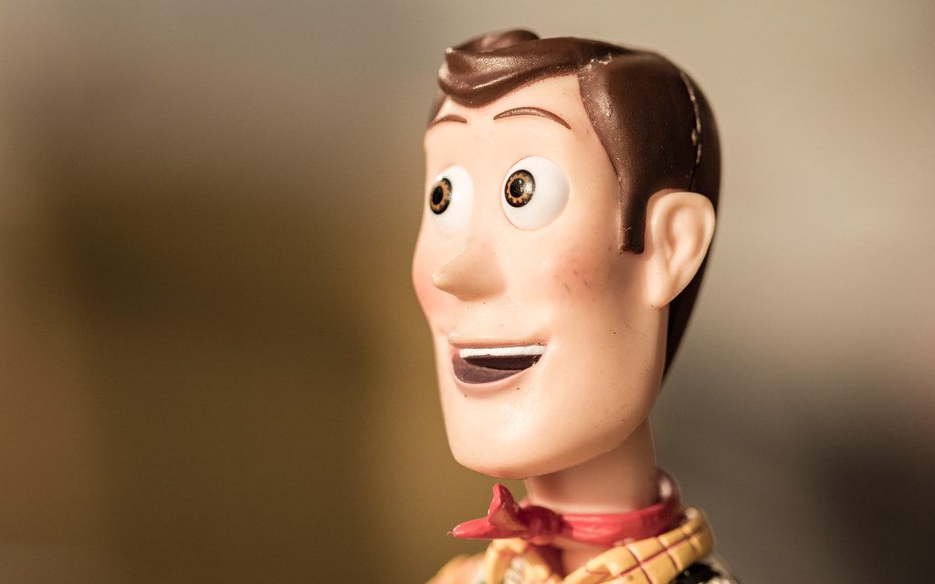
Close-up shots
used to show a person’s face closely. Any shot from close range to focus on a particular object can be called a close-up shot.
Close-up shots are used to capture the subtle expressions on an actor’s face. The frame would be filled
by a person’s face.
Two types of close-up shots are medium close-up and extreme close-up. A shot that captures a person’s head and shoulders is called a medium close-up shots. A shot that focuses on a person’s subtle body features like body movements of eyes, nose is known as an extreme close-up shot.
Close-up shot can bring emotions to a scene and are inevitable in drama films.
D W Griffith and George Albert Smith are well known for the effective use of close-up shots.
This Photo by Unknown Author is licensed under CC BY-SA-NC

Slide 8
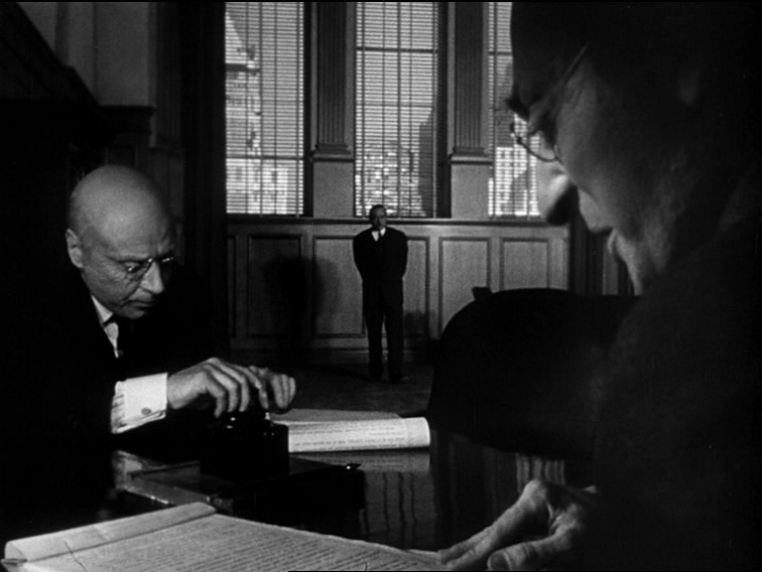
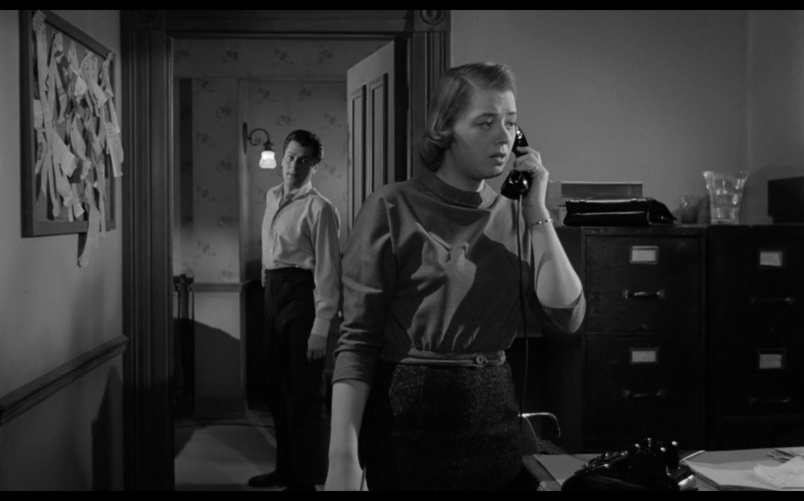
Deep focus
Deep focus is a cinematographic technique where objects near the camera as well as far away from it are focussed at the same time.
Wide-angle lenses are used in deep diligently.
It focuses on the foreground, middle ground and background of the object.
Deep focus shots give freedom to the viewers to choose their objects of attention.
The possibility to draw multiple meanings from a single shot is enhanced.

Slide 9
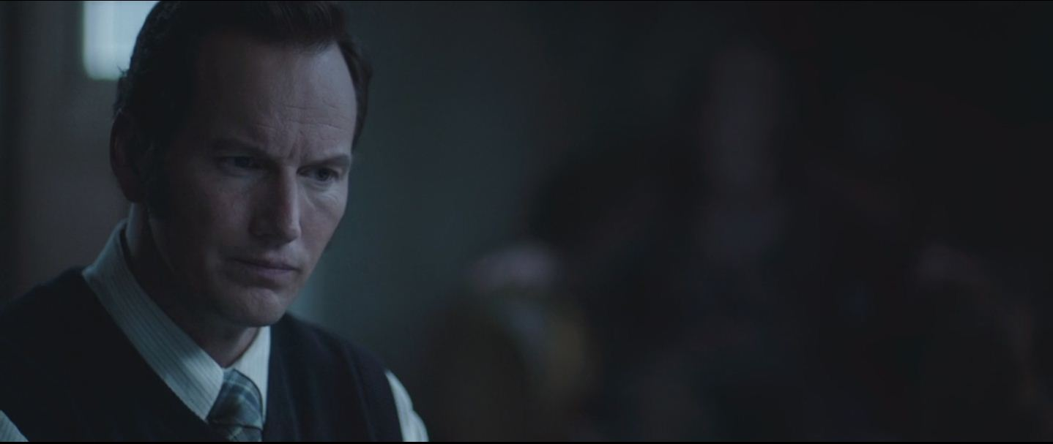
SHALLOW FOCUS
Shallow focus is a cinematographic technique, which is the exact opposite of deep focus’.
Only a single object or area is focused and the rest is left out of focus. The focus is limited only to a small field. Usually the background is blurred.
Shallow focus helps to bring the viewers attention to a single object.
The subject, which is in focus, is completely isolated from its surroundings.
Shallow focus has become a common technique in filmmaking from 2000s onwards. It can be helpful to bringdown the cost of film making.

Slide 10
Thank You

