Slide 1
MUTUAL FUNDS
Dr. SHAJI MARAM VEETTIL
Associate Professor of Commerce & HOD
RSM SNDP Yogam College, Koyilandy

Slide 2
Mutual Fund - Introduction
A mutual fund is a type of investment vehicle that pools money from multiple investors and uses that money to invest in a diversified portfolio of stocks, bonds, or other securities.
These funds are managed by professional portfolio managers who make investment decisions on behalf of the fund's investors.
Mutual funds are a popular investment choice for individuals who want to access a diversified portfolio without having to select and manage individual securities themselves.

Slide 3
Definition of Mutual Fund
SEBI (Mutual Fund) Regulation, 1996 defines mutual funds as”a fund established in the form of a trust to raise monies through the sale of units to the public or a section of the public under one or more schemes for investing in securities, money market instruments, gold or gold related instruments, silver or silver related instruments, real estate assets and such other assets and instruments as may be specified by the Board from time to time.”

Slide 4
Key features of mutual funds
Diversification: Mutual funds typically invest in a wide range of securities, which helps spread risk. This diversification can reduce the impact of poor performance by any single investment.
Professional Management: Mutual funds are managed by experienced fund managers who make investment decisions based on the fund's objectives and strategies.
Liquidity: Mutual fund shares can usually be bought or sold on any business day, and the price is determined by the fund's net asset value (NAV), which is calculated at the end of each trading day.
Variety of Options: There are various types of mutual funds, each with its own investment strategy and focus. Some common types include equity funds (investing in stocks), bond funds (investing in bonds), money market funds (investing in short-term, low-risk securities), and hybrid funds (combining various asset classes).
Affordability: Mutual funds allow investors to start with relatively small amounts of money, making them accessible to a wide range of individuals.
Transparency: Mutual funds are required to provide regular reports to their investors, including information about their holdings, performance, and expenses.
Fees and Expenses: Investors typically pay fees, such as management fees and expense ratios, for the services and administration of the fund. These costs can vary among different funds.
Distribution: Some mutual funds offer distribution options, such as reinvesting dividends or receiving them as cash payouts.

Slide 5
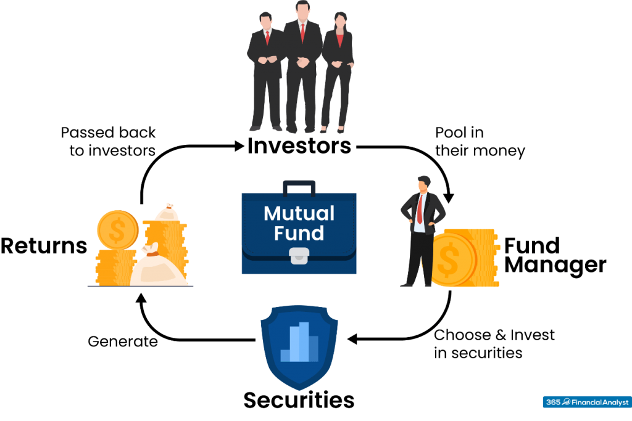
How does Mutual Fund work

Slide 6
Organisation/Structure of Mutual Funds
Sponsor: The sponsor is the organization or financial institution that establishes the mutual fund. The sponsor plays a pivotal role in the setup of the fund and appoints the trustees and asset management company.
Trustees: Mutual funds are structured as trusts, and trustees are responsible for overseeing the operations of the fund to ensure that it complies with the regulations and the trust deed. The trustees work independently and are responsible for safeguarding the interests of the unit holders (investors).
Asset Management Company (AMC): The asset management company, often referred to as the fund manager, is responsible for the day-to-day operations of the mutual fund. This includes managing the fund's portfolio, making investment decisions, and ensuring that the fund operates within the stated objectives and strategies.
Custodian: The custodian is responsible for safeguarding the fund's assets, such as stocks, bonds, and other securities. They hold the physical securities and ensure that they are not subject to fraud or mismanagement.
Registrar and Transfer Agent: These entities are responsible for handling investor services, such as processing purchase and redemption requests, maintaining records of unit holders, and handling communication with investors.
Distributor: Distributors play a crucial role in marketing the mutual fund to investors and facilitating the sale of units.
Unit Holders (Investors): Individual and institutional investors who purchase units or shares of the mutual fund.
Investment Portfolio: The mutual fund's assets are invested in a diversified portfolio of securities, such as stocks, bonds, money market instruments, or other assets, based on the fund's investment objectives.
Net Asset Value (NAV): The NAV represents the per-unit value of the mutual fund and is calculated by dividing the total value of the fund's assets minus its liabilities by the number of outstanding units.
Compliance Officer: Many mutual funds appoint a compliance officer to ensure that the fund complies with all regulatory requirements and internal policies.

Slide 7
Types of Mutual Fund Schemes
There are a number of mutual funds to suit the needs and preferences of investore. They may be classified under five broad categories:
  According to ownership
  According to scheme of operation
  According to portfolio or objectives
  According to risk profile
  Based on taxation

Slide 8
Classification based on ownership:
  Public sectoe mutual funds
  Private sector mutual fund
Classification based on scheme of operation
  Open ended funds
  Close ednded funds
  Interval scheme
Classification based on portfolio or objective
  Income funds
  Growth funds
  Balanced or conservative funds
  Stock/Equity funds
  Index funds
  Bond funds
  Specialised funds
  Gold mutual funds
  Fund of funds

Slide 9
Classification based on risk profile
  High-risk funds
  Low-risk funds
Classification based on taxation
  Equity-Linked Savings Schemes (ELSS)
  Non-ELSS Funds

Slide 10
Advantages of Mutual Funds
Diversification: Mutual funds pool money from multiple investors and invest in a diversified portfolio of securities. This diversification spreads risk across various assets, reducing the impact of poor performance in any single investment.
Professional Management: Mutual funds are managed by experienced portfolio managers or investment professionals who make informed investment decisions on behalf of investors. Their expertise can help optimize investment strategies.
Accessibility: Mutual funds are accessible to a wide range of investors, including those with limited capital. Many funds have low minimum investment requirements, making it easier for individuals to invest.
Liquidity: Mutual fund shares can typically be bought or sold on any business day at the net asset value (NAV) price, providing investors with liquidity and flexibility.
Affordability: Investors can access a diversified portfolio of assets with a relatively small investment. This is especially beneficial for those who may not have the financial resources to buy individual securities.
Risk Management: Mutual funds come in various risk profiles, from conservative to aggressive, allowing investors to select funds that align with their risk tolerance and financial goals.
Regulation: Mutual funds are regulated by government authorities or regulatory bodies in many countries, providing a level of investor protection and transparency.

Slide 11
Professional Research and Analysis: Fund managers and research teams conduct thorough research and analysis to select the best investment opportunities, which can be challenging for individual investors to replicate.
Automatic Reinvestment: Many mutual funds offer automatic reinvestment of dividends and capital gains, allowing investors to benefit from compounding and potentially higher returns over time.
Choice and Variety: There is a wide variety of mutual funds available, each with its own investment strategy, focus, and objectives. Investors can choose funds that align with their specific investment preferences and financial goals.
Tax Efficiency: Some mutual funds offer tax benefits or efficient tax management strategies. For example, tax-saving mutual funds (ELSS) may offer tax deductions in certain countries.
Transparency: Mutual funds are required to provide regular reports to investors, including information about their holdings, performance, and expenses. This transparency allows investors to monitor the fund's progress.
Professional Administration: Fund administrators handle various operational aspects, such as record-keeping, accounting, and reporting, relieving investors of administrative burdens.
Automatic Rebalancing: Balanced and asset allocation funds automatically rebalance their portfolios to maintain the desired asset allocation, which helps investors stick to their investment strategy.
Cost Efficiency: Mutual funds benefit from economies of scale, which can lead to lower transaction costs and management fees compared to individual investors buying and selling securities on their own.

Slide 12
Disadvantages of Mutual Funds
Management Fees: Mutual funds charge fees for managing and administering the fund, including management fees and expense ratios. These fees can erode a portion of the returns earned by investors.
Lack of Control: When you invest in a mutual fund, you delegate control over investment decisions to the fund manager. This means you have no say in the specific securities the fund buys or sells.
Capital Gains Distributions: Mutual funds can generate capital gains from trading within the portfolio. These gains are typically distributed to investors, which may result in tax liabilities, even if you didn't sell your fund shares.
Redemption Fees: Some funds impose redemption fees when investors sell their shares within a specified period. This can discourage short-term trading but may also hinder liquidity for investors.
Tax Inefficiency: Tax consequences can vary based on the fund's activities. Frequent buying and selling of securities within the fund can lead to capital gains distributions, which may be taxed at different rates.
No Guarantees: Unlike bank deposits, mutual funds are not guaranteed by the government or a financial institution. The returns are subject to market risks, and there is no assurance of capital preservation or fixed returns.

Slide 13
Inherent Risks: Mutual funds, particularly equity funds, are subject to market risk. They can experience losses due to market downturns or economic factors. The level of risk varies based on the fund's investment objectives and asset allocation.
Lack of Customization: Mutual funds have predefined investment objectives and strategies. They may not perfectly align with an individual investor's unique financial goals and risk tolerance.
Trailing Commissions: In some regions, mutual fund sales come with trailing commissions paid to financial advisors or brokers. This can lead to a potential conflict of interest if advisors recommend funds with higher commissions.
High Portfolio Turnover: Some mutual funds engage in frequent buying and selling of securities, which can result in higher transaction costs and potential capital gains tax for investors.
Market Timing: Large inflows or outflows of capital can create market timing issues, where fund managers need to buy or sell securities in response to investor activity. This can impact performance.
Front-End and Back-End Loads: Some funds charge front-end loads (fees when purchasing shares) or back-end loads (fees when selling shares). These loads can reduce the amount of money initially invested or received upon redemption.
Tracking Error: Index funds and ETFs aim to replicate a market index's performance. However, they may not perfectly track the index due to factors like tracking error, management fees, and trading costs.
Limited Control Over Taxes: Tax considerations in mutual funds are typically handled at the fund level, which may not be tax-efficient for individual investors.

Slide 14
Lease Financing (Leasing)
Leasing is a financial arrangement in which one party, the lessor, allows another party, the lessee, to use an asset such as a vehicle, real estate, or equipment for a specified period in exchange for regular payments.
The lessee essentially rents the asset for an agreed-upon duration, typically in the form of monthly lease payments.
It is a method of acquiring the use of an asset without procuring it.

Slide 15
Key aspects of leasing
Asset Usage: The lessee gains the right to use the asset for a specific period without having to purchase it outright.
Duration: Leases have a fixed term, which can vary from months to several years, depending on the type of lease and the agreement between the lessor and lessee.
Payments: The lessee makes regular payments to the lessor for the use of the asset. These payments are typically lower than the cost of purchasing the asset because the lessee does not take full ownership.
Ownership: The lessor retains ownership of the asset during the lease term, and the lessee typically has no ownership rights. However, some leases may include an option for the lessee to purchase the asset at the end of the lease term.

Slide 16
Types of Leases
There are several types of leasing arrangements, each designed to meet specific needs and financial objectives. The primary types of leasing include:
Operating Lease: An operating lease is a short-term lease in which the lessee doesn't assume the risks and rewards of ownership. It is typically used for assets like vehicles or equipment where the lessee only needs them for a limited period. At the end of the lease term, the lessee can typically return the asset, renew the lease, or purchase the asset at its fair market value.
Finance Lease (Capital Lease): A finance lease is a long-term lease in which the lessee essentially assumes the risks and rewards of ownership. This type of lease is often used for assets that the lessee intends to use for a significant portion of the asset's useful life. The lessee is responsible for the maintenance and insurance of the asset and may have the option to purchase it at the end of the lease term at a predetermined price.
Sale and Leaseback: In a sale and leaseback arrangement, a business that owns an asset sells it to a lessor and then leases it back. This allows the business to free up capital tied up in the asset while retaining the ability to use it. It's a way to access cash without selling the asset outright.
Direct Lease: In a direct lease, a lessee leases an asset directly from the lessor. This is the most straightforward type of lease arrangement.

Slide 17
Cross Border Lease: Cross-border leases involve assets located in one country being leased to a lessee in another country. These leases often involve complex tax and legal considerations.
Net Lease: In a net lease, the lessee is responsible for not only lease payments but also additional costs such as property taxes, insurance, and maintenance expenses. There are variations of net leases, including single net lease, double net lease, and triple net lease, depending on the extent of additional costs the lessee is responsible for.
Leveraged Lease: In a leveraged lease, a lessor borrows a significant portion of the funds needed to purchase an asset, and the lessee makes lease payments that cover the debt service and provide a return to the lessor. This type of lease involves three parties: the lessor, the lessee, and the lender.
A consortium lease refers to a lease arrangement involving a consortium of multiple lessors or financiers who collectively provide funding or assets to a lessee. This type of lease is typically used for large and complex projects or assets that require substantial financial resources.

Slide 18
Apecialized service lease: A specialized service lease refers to a type of leasing agreement where the lessor provides not only the equipment or asset to the lessee but also specialized services related to the maintenance, operation, or support of the leased asset. This type of lease is particularly common in industries where the proper functioning and maintenance of specialized equipment or assets are critical for business operations.
Consumer Lease: A consumer lease, also known as a personal lease, is a type of lease agreement designed for individuals or consumers to lease personal items or assets, typically for personal use rather than for business purposes. Consumer leases are commonly used for items like cars, appliances, electronics, furniture, and other household goods.
Front-Loaded Lease: This term refers to a lease agreement in which the majority of the financial obligations or costs are incurred at the beginning of the lease term. This could mean higher initial lease payments or upfront fees. For example, in an automobile lease, a front-loaded lease might involve higher monthly payments in the early months of the lease, with lower payments as the lease term progresses.
Back-Loaded Lease: A back-loaded lease refesr to a lease agreement in which the majority of the financial obligations are concentrated toward the end of the lease term. In this case, the lessee might have lower initial costs or payments, with expenses increasing as the lease progresses. This type of lease structure could be designed to align with a lessee's expected increasing ability to cover costs over time.
Balloon Lease: It is a kind of lease, where the lease rentals are low in the biginning, high during the mid period and low again during the end of the lease.

Slide 19
Advantage of Leasing
Conservation of Capital: Leasing allows businesses and individuals to conserve their capital since they don't have to make a significant upfront payment to acquire the asset. This is particularly beneficial for businesses that prefer to use their available funds for other essential operations or investments.
Lower Initial Costs: Lease agreements often require lower initial costs compared to purchasing an asset outright. This can be especially helpful for businesses that need to acquire expensive equipment or machinery but may not have the immediate financial capacity to make a large upfront payment.
Flexibility: Leasing provides flexibility, allowing businesses and individuals to access the latest models and technology without the long-term commitment of ownership. This is particularly advantageous for industries where technology and equipment are continually evolving.
Tax Benefits: Depending on the type of lease and local tax regulations, businesses may be able to deduct lease payments as operating expenses, which can result in significant tax benefits. It's essential for businesses to consult with tax professionals to understand the specific tax advantages associated with leasing in their jurisdiction.
Maintenance and Upkeep: In some lease agreements, the lessor may be responsible for maintenance and repairs, relieving the lessee of the burden of these additional costs. This can help businesses avoid unexpected maintenance expenses and budget more effectively.
Improved Cash Flow: Because lease payments are typically spread out over time, businesses can manage their cash flow more effectively. This can be particularly beneficial for businesses with seasonal fluctuations or irregular revenue streams.
Access to Higher-End Equipment: Leasing allows businesses and individuals to access higher-end equipment or assets that may be otherwise unaffordable. This can help businesses stay competitive and improve their operational efficiency without the need for significant capital investment.
Easier Upgrades: Leasing provides the option to easily upgrade to newer models or equipment at the end of the lease term, allowing businesses to stay up-to-date with the latest technology and industry trends.

