Slide 1
STRATEGIC MANAGEMENT PROCESS
Dr. Sandhya.P.Pillai
Associate Professor Commerce
RSM SNDP Yogam College
Koyilandy

Slide 2
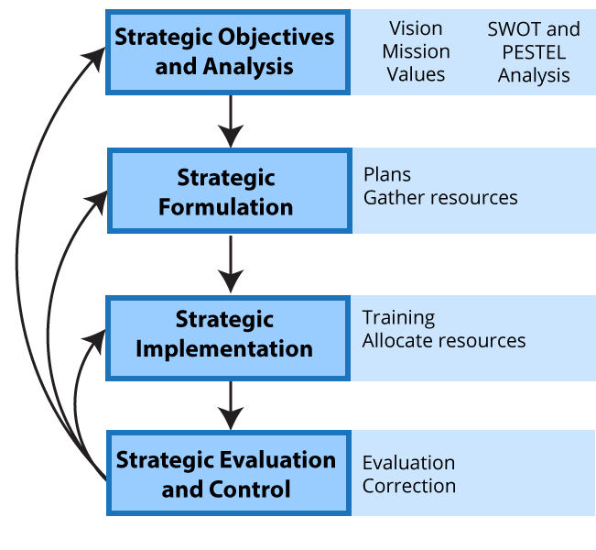
STRATEGIC MANAGEMENT PROCESS

Slide 3
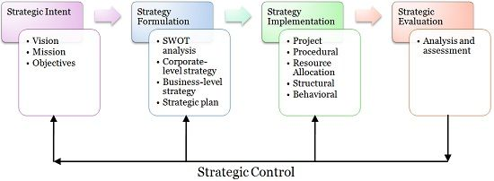
STRATEGIC MANAGEMENT PROCESS

Slide 4
STRATEGIC MANAGEMENT PROCESS
The strategic management process is the process of defining and implementing an organization's strategy. This is a process that helps the organizations to plan, monitor, analyze, and assess their needs to achieve their goals and objectives. The process can have both financial and nonfinancial benefits.
It involves:
Analyzing the business's current situation
Developing a plan to meet goals
Implementing the plan

Slide 5
STEPS IN STRATEGIC MANAGEMENT PROCESS
Mission and Vision Development
This step involves defining the organization's purpose (mission) and its aspirations for the future (vision). The mission statement communicates the fundamental purpose of the organization, while the vision statement outlines its long-term goals and aspirations.
Defining the levels of strategic intent of the business:-
Establishing vision
Designing mission
Setting objectives

Slide 6
2. Environmental Analysis
Organizations need to assess both internal and external environments to understand their current position and anticipate future opportunities and threats. This involves conducting analyses such as SWOT (Strengths, Weaknesses, Opportunities, Threats) analysis, PESTEL (Political, Economic, Social, Technological, Environmental, Legal) analysis, competitor analysis, and market analysis.

Slide 7
3. Strategy Formulation
Based on the insights gained from environmental analysis, organizations develop strategies to achieve their long-term objectives. This step involves identifying strategic goals and selecting the most appropriate course of action to accomplish them. Strategies may involve decisions related to market positioning, product development, diversification, partnerships, mergers and acquisitions, etc.

Slide 8
Formulation of Strategy
Formulation of strategy requires:-
Performing environmental and organizational appraisal
Considering strategies
Carrying out strategic analysis
Making strategies
Preparing strategic plan

Slide 9
4. Strategy Implementation
Once the strategies are formulated, they need to be executed effectively. This involves translating strategic plans into action by allocating resources, setting objectives, designing organizational structures, implementing policies and procedures, and communicating the strategic direction throughout the organization. Implementation of strategy involves:-
Putting strategies into practice
Developing structures and systems
Managing behavioral and functional implementation

Slide 10
5. Performance Measurement and Evaluation
Organizations must continuously monitor and evaluate their performance to ensure that strategic objectives are being met. Key performance indicators (KPIs) are established to measure progress, and performance against these indicators is regularly reviewed. Feedback from performance evaluations is used to refine strategies and make necessary adjustments.

Slide 11
6. Strategic Control
Strategic control involves monitoring the implementation of strategies and making adjustments as needed to ensure alignment with organizational goals. It includes both corrective actions taken in response to deviations from the planned course and reinforcing actions to capitalize on new opportunities. Strategic Evaluation and Control involves:
Performing evaluation
Exercising control
Recreating strategies

Slide 12
7.Strategic Review and Adaptation
The strategic management process is not static; it requires periodic review and adaptation in response to changes in the internal and external environment. This involves revisiting the organization's mission, vision, and strategic goals, as well as reassessing environmental factors and making adjustments to the strategic plan as necessary.
Strategic Management is all about specifying organization’s vision, mission and objectives, environment scanning, crafting strategies, evaluation and control.

Slide 13
IMPLICATIONS OF STATEGIC MANAGEMENT PROCESS
Enhanced Performance: Implementing strategic management processes can lead to improved organizational performance by aligning activities with long-term goals, optimizing resource allocation, and focusing efforts on activities that create value.
Competitive Advantage: Strategic management helps organizations identify and leverage their competitive advantages, whether through innovation, differentiation, cost leadership, or other strategic approaches. This can result in sustainable competitive advantage in the marketplace.

Slide 14
IMPLICATIONS OF STATEGIC MANAGEMENT PROCESS
3 Adaptability to Change: Strategic management emphasizes environmental analysis and continuous monitoring, enabling organizations to anticipate and respond effectively to changes in the business environment, such as shifts in market trends, technological advancements, or regulatory changes.
4.Resource Allocation Optimization: By prioritizing initiatives and aligning resources with strategic objectives, strategic management ensures that resources are allocated efficiently and effectively, minimizing waste and maximizing the organization's ability to achieve its goals.

Slide 15
IMPLICATIONS OF STATEGIC MANAGEMENT PROCESS
5.Adaptability to Change: Strategic management emphasizes environmental analysis and continuous monitoring, enabling organizations to anticipate and respond effectively to changes in the business environment, such as shifts in market trends, technological advancements, or regulatory changes.
6.Resource Allocation Optimization: By prioritizing initiatives and aligning resources with strategic objectives, strategic management ensures that resources are allocated efficiently and effectively, minimizing waste and maximizing the organization's ability to achieve its goals.

Slide 16
IMPLICATIONS OF STATEGIC MANAGEMENT PROCESS
7.Innovation and Creativity: Strategic management encourages organizations to pursue innovation and creativity in their products, services, and processes. By fostering a culture of innovation, organizations can stay ahead of competitors and adapt to changing customer preferences.
8.Long-term Sustainability: By focusing on long-term objectives and sustainable growth, strategic management helps organizations avoid short-term thinking and actions that may compromise their long-term viability. This includes considerations of environmental, social, and governance factors.

Slide 17
IMPLICATIONS OF STATEGIC MANAGEMENT PROCESS
9.Stakeholder Engagement: Strategic management involves engaging with various stakeholders, including employees, customers, shareholders, and communities. By considering the interests and perspectives of these stakeholders, organizations can build trust, enhance reputation, and create shared value.
Overall, the strategic management process enables organizations to navigate complexity, capitalize on opportunities, mitigate risks, and achieve long-term success in a dynamic and competitive business environment.

Slide 18
Purpose of the Strategic Management Process
The purpose of the strategic management process is to guide organizations in setting and achieving long-term goals in a dynamic and competitive environment. It encompasses the following objectives:
Direction Setting: Establishing a clear mission and vision that define the organization's purpose and desired future state.
Environmental Analysis: Understanding internal strengths and weaknesses as well as external opportunities and threats to inform strategic decision-making.
Strategy Formulation: Developing strategies to achieve organizational objectives based on insights gained from environmental analysis.

Slide 19
Purpose of the Strategic Management Process
Strategy Implementation: Executing strategies effectively by aligning resources, processes, and activities with strategic goals.
Performance Measurement: Monitoring and evaluating performance against strategic objectives using key performance indicators (KPIs).
Adaptation and Improvement: Continuously reviewing and adapting strategies in response to changes in the internal and external environment.

Slide 20
Core Competence
Core competency refers to a unique set of skills, abilities, knowledge, technologies, or resources that an organization possesses and which gives it a competitive advantage over its rivals. These competencies are central to the organization's ability to deliver value to its customers and achieve its strategic objectives.

Slide 21
Core competency- Example
Google's core competency in search algorithms and data analytics enables it to deliver highly relevant search results and targeted advertising, driving its dominance in the online search market.
Apple's core competency in design and user experience allows it to create innovative and aesthetically pleasing products that resonate with consumers, leading to strong brand loyalty and premium pricing.
Toyota's core competency in lean manufacturing and supply chain management enables it to produce high-quality vehicles at lower costs and with shorter lead times compared to competitors.

Slide 22
Thank You

