Slide 1
Android Programming
BY
Chandni PM
Asst.Professor
Dept.of Computer Science
RSM SNDP Yogam College,Koyilandy

Slide 2
Contents
What’s Android
Android architecture
Android software development
‘Hello World’ on Android
More…

Slide 3
What’s Android

Slide 4
Android Phones

Slide 5




Mobile Devices
It’s obvious that mobile device may take the place of PC in future
OS plays a vital part
Processor
Embedded OS
Middleware
Apps
Device

Slide 6


Slide 7
OHA and Android
OHA(Open Handset Alliance) is a group of 71 technology and mobile companies, including Google, Intel, Dell, HTC and China Mobile…
OHA’s aim：
  accelerate innovation in mobile phones
  offer consumers a richer, less expensive, and better mobile experience
OHA developed Android™, the first complete, open, and free mobile platform
OHA was initially called up by Google, and Google is the ‘captain’

Slide 8


What’s Android
Generally, Android is a software stack for mobile devices that includes an operating system, middleware and key applications
Android is based on JAVA and all its applications are developed in JAVA
The JAVA VM, known as Dalvik, is highly customized and optimized for mobile devices
Android SDK offers rich tools for android application development and many useful APIs。
The core of Android

Slide 9
Android Features #1
Application framework enabling reuse and replacement of components
Optimized Java virtual machine: Dalvik
Optimized Graphics Processing, supporting 2D and 3D graphics(OpenGL ES 1.0 )
Integrated open source web browser: WebKit
SQLite for structured data storage

Slide 10
Android Features #2
Multimedia capability, supporting varieties of audio, video and still image formats
GSM Telephony
Bluetooth, EDGE, 3G and Wi-Fi support
Camera, GPS, compass, accelerometer
and other sensors support
Rich development environment, including an emulator, debugging tools, memory probe tools, log tools and powerful eclipse plugins
Hardware dependent

Slide 11
Android architecture

Slide 12
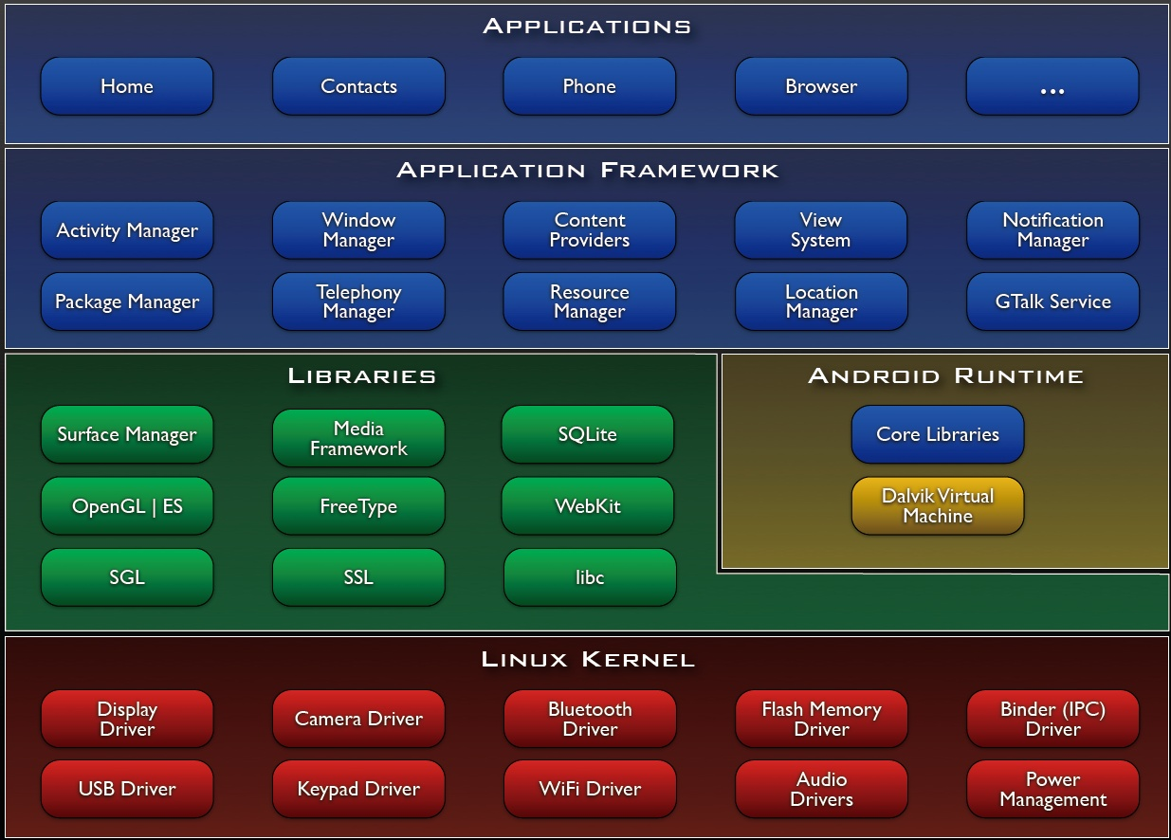

Slide 13
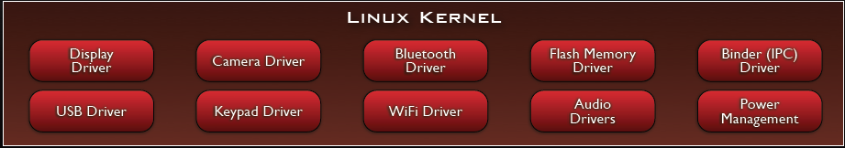
Linux Kernel
Note that Android based on a Linux kernel not a Linux OS
Supplies Security, Memory management, Process management, Network stack and Driver model
Acts as an abstraction layer between the hardware and the rest of the software stack

Slide 14
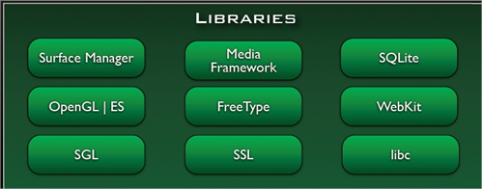
Libraries
Run in system background
Using C/C++ Language
4 types of Libraries
  Bionic Libc, system C libraries
  Function Libraries, supporting multimedia, web browser, SQLite...
  Native Servers
  Hardware
  Abstraction Libraries

Slide 15
Core Libraries
System C library, the standard C system library, tuned for embedded Linux-based devices
Media Libraries, support playback and recording of many popular audio and video formats, as well as image files, including MPEG4, H.264, MP3, AAC, AMR, JPG, and PNG
Surface Manager, manages access to the display subsystem and seamlessly composites 2D and 3D graphic layers from multiple applications
WebKit, a modern web browser engine which powers both the Android browser and an embeddable web view
SGL, the underlying 2D graphics engine
3D libraries, an implementation based on OpenGL ES 1.0 APIs
FreeType , bitmap and vector font rendering
SQLite , a powerful and lightweight relational database engine

Slide 16
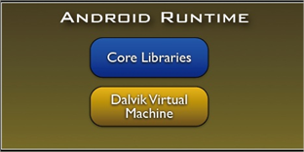
Andoid Runtime
The core of Android platform
Dalvik Virtual Machine
  Register-based
  Executes files in the Dalvik Executable (.dex) format
Java core Libraries
  Provides most of the functionality of the Java programming language.

Slide 17
Android Runtime (cont.)
The functions of Java core libraries rely on the Dalvik VM and the underlying Linux kernel
Multiple Dalvik VMs may run at the same time
Every Android application runs in its own process, with its own instance of the Dalvik virtual machine
  The "dx" tool in Android SDK can transform compiled JAVA class into the .dex format

Slide 18
Dalvik Virtual Machine
Android custom implementation virtual machine
  Provides application portability and runtime consistency
  Runs optimized file format (.dex) and Dalvik bytecode
  Java .class / .jar files converted to .dex at build time
Designed for embedded environment
  Supports multiple virtual machine processes per device
  Highly CPU-optimized bytecode interpreter
  Efficiently Using runtime memory
Core Libraries
  Core APIs for Java language provide a powerful, yet simple and familiar development platform

Slide 19
DVM vs. JVM
DVM
  Google
  Dalvik executable
  Only supports a subset of standard Java Library
JVM
  Sun
  Java bytecode
Some worries that Java world may be divided into different communities, each has its own Java standard

Slide 20
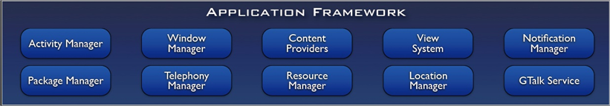
Application Framework
Simplify the reuse of components
  Applications can publish their capabilities and any other application may then make use of those capabilities
Applications is a set of services and systems, include
  Views system, content providers, resources manager and so on

Slide 21
Application Framework (cont.)
Activity Manager, manages the lifecycle of applications and provides a common navigation backstack
Notification Manager, enables all applications to display custom alerts in the status bar
Resource Manager, providing access to non-code resources such as localized strings, graphics, and layout files
Content Providers, access data from other applications (such as Contacts), or to share their own data
Views, used to build an application, including lists, grids, text boxes, buttons, and even an embeddable web browser

Slide 22
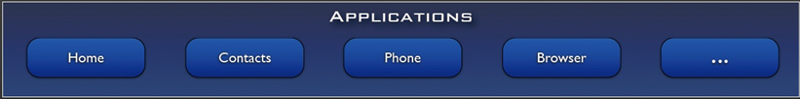
Applications
A set of core applications shipped with Android platform
  an email client, SMS program, calendar, maps, browser, contacts, and others
All written in Java
Our applications are in the same level as these applications

Slide 23
Android software development

Slide 24
Development Environment
IDE – Eclipse
Eclipse plug-in - ADT
Software Development Kit (SDK)
Android Emulator
Debugger

Slide 25
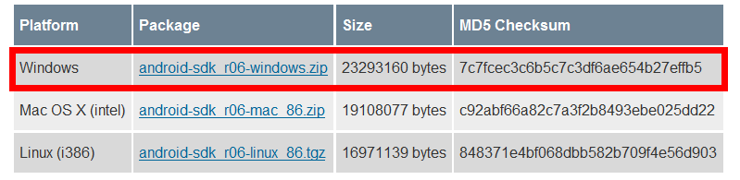
Setup Android SDK
Download Android SDK and extract the zip file to an arbitrary folder
  http://androidappdocs.appspot.com/sdk/index.html
  E.g.: extract to C:\
  The SDK will be used by ADT in eclipse

Slide 26
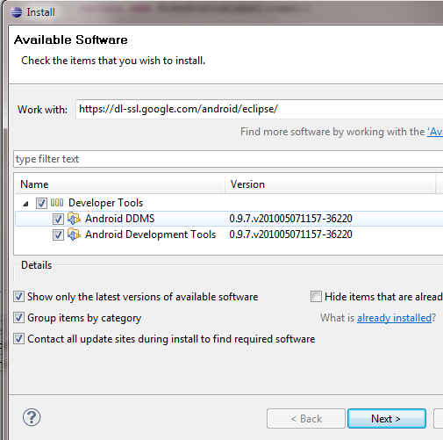
Setup ADT plugin
Install Eclipse ADT plugin
  Eclipse must be J2EE edition, 3.5 recommended
  Update site: https://dl-ssl.google.com/android/eclipse/
  Install all the plugins in the repository
  Restart needed after installation

Slide 27
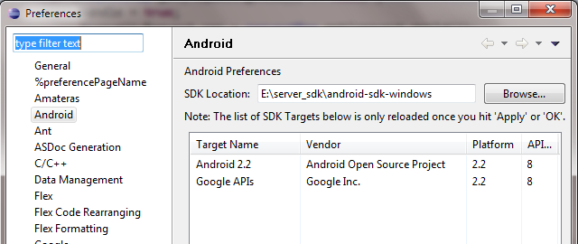
Configure ADT Plugin
Open eclipse Window->Preferences, select Android
Setup the SDK location as the folder where you extracted the downloaded SDK zip file

Slide 28
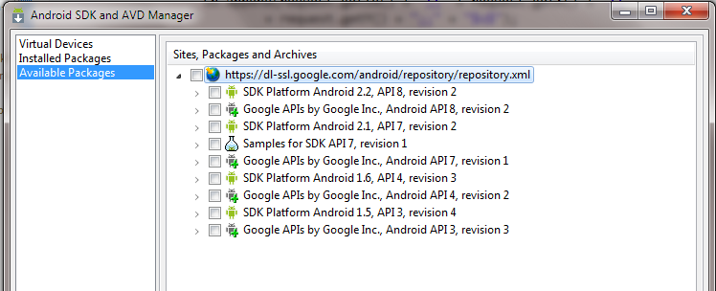
Setup SDK APIs
Open Window->Android SDK and AVD Manager
Click Available Packages and then choose proper APIs to install, the latest may be the best

Slide 29
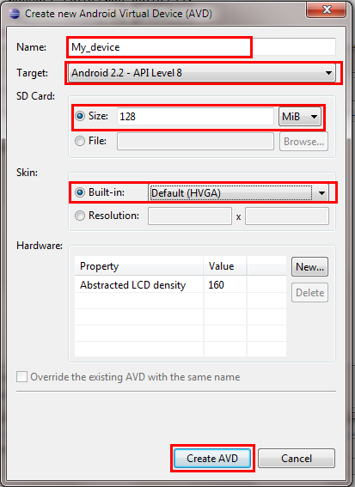
Setup Emulators
After SDK APIs installation, click Virtual Devices
Click new, there will be a dialog
  input a name
  choose a running target and a skin
  specify the SD card size

Slide 30
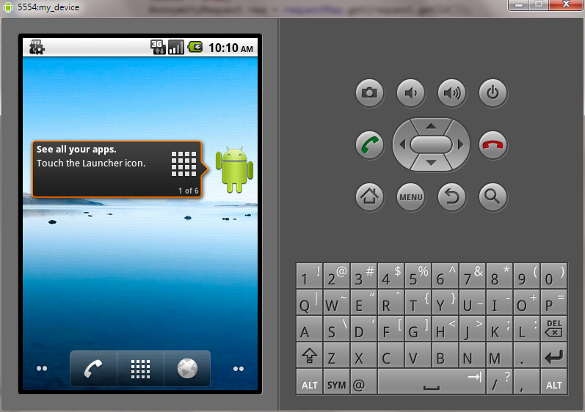
Ready…
Now you may start the AVD
  Click start to start the new AVD
  First start-up may take a very long time

Slide 31
‘Hello World’ on Android

Slide 32
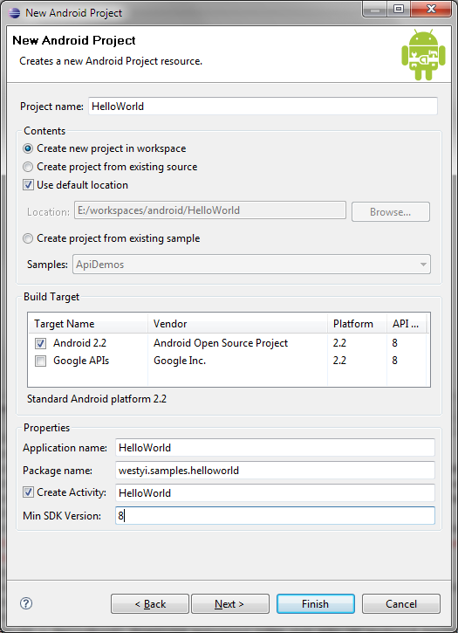
Create a new Android Project
Open File->New->Android project
  Project name
  Build Target
  Application name
  Package name
  Create Activity

Slide 33
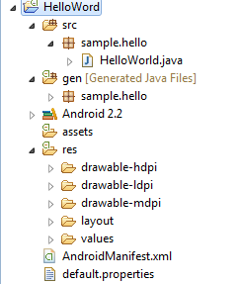
Hello World Project
src: source folder
gen: SDK generated file
android 2.2: reference lib
assets: binary resources
res: resource files and resource description files
AndroidManifest.xml: application description file
default.properties: project properties file

Slide 34

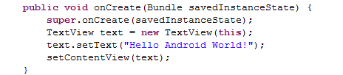
Say Hello World
modify HelloWorld.java

Slide 35
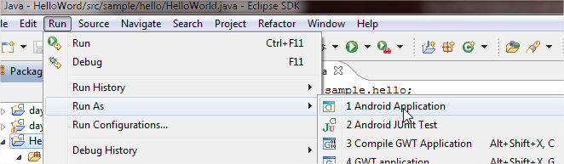
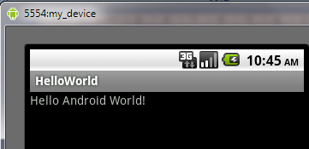
Run Hello World
Select HelloWorld Project, Run->Run as->Android Application
ADT will start a proper AVD and run HelloWorld app on it

Slide 36
Behind HelloWorld #1
R.java, generated by Android SDK, represents all the resources of the app. resources are all in res folder
resources are pre-compiled into binary format
/* AUTO-GENERATED FILE. DO NOT MODIFY.
*
* This class was automatically generated by the
* aapt tool from the resource data it found. It
* should not be modified by hand.
*/
package sample.hello;
public final class R {
public static final class attr {
}
public static final class drawable {
public static final int icon=0x7f020000;
}
public static final class layout {
public static final int main=0x7f030000;
}
public static final class string {
public static final int app_name=0x7f040001;
public static final int hello=0x7f040000;
}
}

Slide 37
Behind HelloWorld #2
res/layout , contains layout declarations of the app, in XML format, UIs are built according to the layout file
Linear Layout
main.xml
<?xml version="1.0" encoding="utf-8"?>
<LinearLayout
xmlns:android=http://schemas.android.com/apk/res/android
android:orientation="vertical"
android:layout_width="fill_parent"
android:layout_height="fill_parent">
<TextView android:layout_width="fill_parent"
android:layout_height="wrap_content"
android:text="@string/hello" />
</LinearLayout>
TextView, display static text
A reference to String resource ‘hello’

Slide 38
Behind HelloWorld #3
res/values, contains string declarations or other values(e.g.:colors) of the app
  string.xml, contains string resources
<?xml version="1.0" encoding="utf-8"?>
<resources>
<string name="hello">Hello World, HelloWorld!</string>
<string name="app_name">HelloWorld</string>
</resources>
referenced in res/layout/main.xml
referenced in AndroidManifest.xml

Slide 39

Behind HelloWorld #4
res/drawable, contains all image resources
  folders may have suffixes, app will choose the most suitable one, so do the other resources
  three folders: drawable-ldpi, drawable-hdpi, drawable-mdpi, each contains an icon.png file
  app will choose the proper icon according to the device DPI
  reference name:@drawable/icon
other folders we may use in future
  menu, anim (animation), xml ( preference and searchable)

Slide 40
Behind HelloWorld #5
AndroidManifest.xml describe the application
  declare app’s name, version, icon, permission, etc…
  declare the application's components: activity, service ,receiver or provider
<?xml version="1.0" encoding="utf-8"?>
<manifest xmlns:android="http://schemas.android.com/apk/res/android"
package="sample.hello" android:versionCode="1" android:versionName="1.0">
<application android:icon="@drawable/icon" android:label="@string/app_name">
<activity android:name=".HelloWorld" android:label="@string/app_name">
<intent-filter>
<action android:name="android.intent.action.MAIN" />
<category android:name="android.intent.category.LAUNCHER”/>
</intent-filter>
</activity>
</application>
<uses-sdk android:minSdkVersion="8" />
</manifest>

Slide 41
Core Components-Activity #1
Basically, An activity presents a visual user interface for one focused endeavor the user can undertake
An application might consist of just one activity or several, each Activity is derived from android.app.Activity and should be declared in AndroidManifest.xml file
Each activity is given a default window to draw in, the window may be full screen or smaller and on top of other window
The visual content of the window is provided by a hierarchy of views — objects derived from the base View class
Activity.setContentView() method is used to set a certain hierarchy of view objects

Slide 42
Core Components-Activity #2
Activities are activated by asynchronous messages called intents
  An intent is an Intent object that holds the content of the message
  The action being requested or the URI of the data to act on
The <intent-filter> label in AndroidManifest.xml file specifies the Intent that can start the Activity
  declares the main activity, it will be started automatically when the app starts
An activity is launched (or given something new to do) by passing an Intent object to Context.startActivity() or Activity.startActivityForResult()

Slide 43
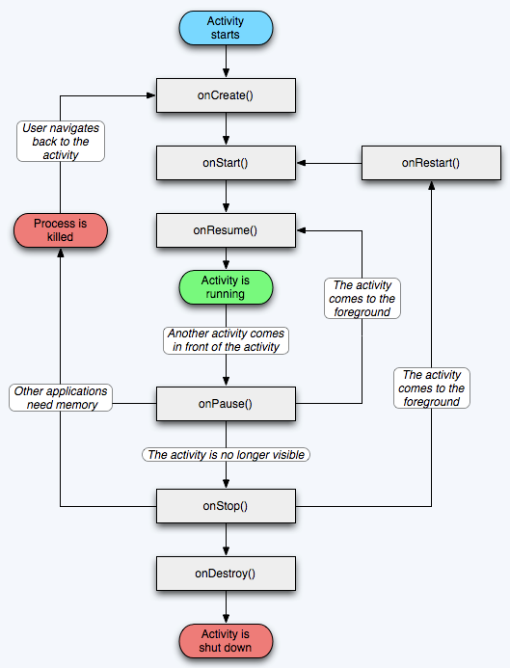
Activity lifecycle

Slide 44
Other Core Components
Service
  A service doesn't have a visual user interface, runs in the background for a period of time
Broadcast receivers
  a component that does nothing but receive and react to broadcast announcements
Content providers
  A content provider makes a specific set of the application's data available to other applications.
  The data can be stored in the file system, in an SQLite database, or in any other manner that makes sense

Slide 45
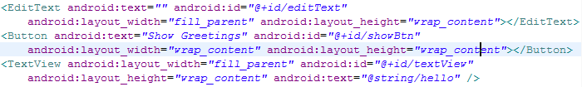
Beyond HelloWorld #1
Build up an app that you can input your greetings and display your greetings
  Input: EditText
  Display: TextView
  Of course, we have to add an button
Edit res/layout/main.xml file to add these components
  each has an android:id property, used to reference it in code

Slide 46

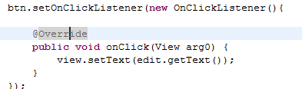
Beyond HelloWorld #2
modify HelloWorld.java
  firstly get the references declared in main.xml
  then add event response for Button

Slide 47
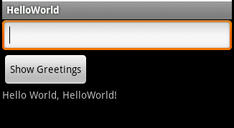
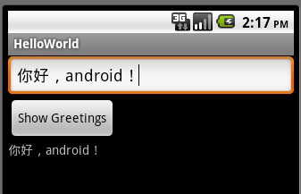
Beyond HelloWorld #3
Finished!
Run->Run as->Android Application
Quite easy, isn’t it?

Slide 48
Useful Materials
Android SDK, Tutorial, Concepts and API docs
Android Development Community
http://www.anddev.org/
http://androidappdocs.appspot.com/index.html
Android Official Site
http://www.android.com
30 Days Android Apps Development
http://bakhtiyor.com/category/30-days-of-android-apps/

