Slide 1
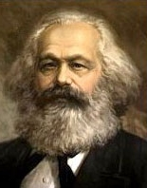
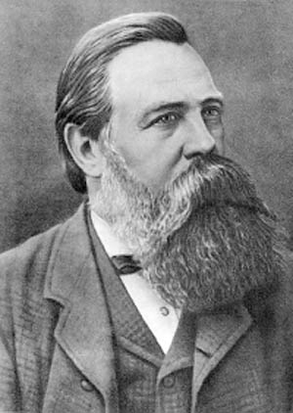
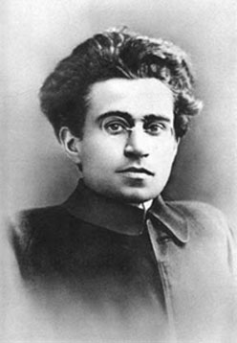
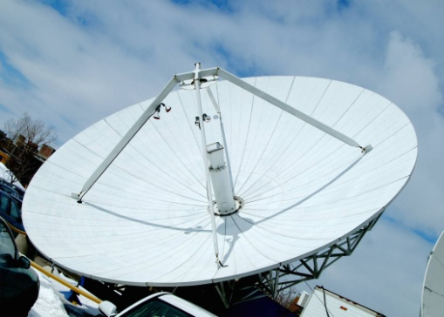
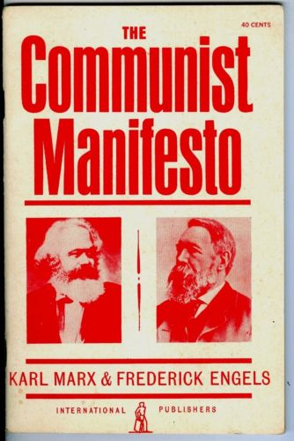


Marxism, Cultural Hegemony
...and the Media

Slide 2
Dominant Ideology and the media
An ideology is a belief system that is constructed and then embedded in the public consciousness by the media.
Media texts represent the world usually in order to support a dominant ideology.
For example, newspapers often promote the dominant ideology of patriotism through their representation of race and nationality.

Slide 3





Some dominant ideologies
Capitalism. The production of capital and consumption of surplus value as a life goal.
Patriotism. To love, support and protect one’s country and its people.
Marriage and family. The “right way” to live is to marry an opposite-sex partner and have children.
Male superiority. Men are more suited to positions of power, and more suited to decision-making at work and at home.

Slide 4
Marxism
Marxism is an economic and socio-political world view that contains within it a political ideology for how to change and improve society by implementing socialism.
It was originally developed in the early to mid nineteenth century by two German émigrés living in Britain, Karl Marx and Friedrich Engels. Marxism is based upon a materialist interpretation of history – social groups are driven by creating and maintaining wealth.
Karl Marx
Friedrich Engels

Slide 5
Class struggle
Marx and Engels believed that social change occurs because of the struggle between different classes within society who are constantly competing to improve their conditions.
The Marxist analysis leads to the conclusion that capitalism, the currently dominant form of economic management, leads to the oppression of the proletariat who not only make up the majority of the world's populace but who also spend their lives working for the benefit of the bourgeoisie, the wealthy ruling class in society.
Workers (Proletariat)
‘Fat Cats’ (Bourgeoisie)

Slide 6
To correct this inequality between the bourgeoisie, who are the wealthy minority, and the proletariat, who are the poorer majority, Marxism advocates, and believes in the historical inevitability, of a proletarian revolution, when the proletariat take control of government, and then implement reforms to benefit their class, namely the confiscation of private property which is then taken under state control and run for the benefit of the people rather than for the interests of private profit.
Such a system is socialism, although Marxists believe that eventually a socialist society would develop into an entirely classless system, which is known as communism in Marxist terminology.

Slide 7
Marxism
Marx died in 1883 but his ideas still have a resonance today. Marx was an economist and philosopher and wrote his Communist Manifesto in1848. In it he advocated workers across the world should unite against their oppressors, the ruling classes, who were also their employers.
He wrote: ‘Workers of all lands unite, you have nothing to lose but your chains’.
His ideas led to the development of Communist political systems around the world. In Eastern Europe these lasted until 1989. In this year the Berlin Wall was pulled down and communism here was abandoned as the dominant political philosophy, although it still exists in countries such as China, North Korea and Cuba.

Slide 8

Marx and Capitalism
Although Marx was alive long before the mass media we know today, his ideas help us to understand media theory.
In Marx’s view, all social and cultural institutions such as the family, the education system and the legal system as well as the mass media (which in his day would have been primarily the newspaper) are shaped by the economic basis of society. Therefore an understanding of the economic sphere is essential to any understanding of the role played by the mass media in society.
This means we need to know something about capitalism...

Slide 9
The two social classes in a capitalist society
In capitalist economies, one group of people (the ruling class or bourgeoisie) own the capital (money) to invest in factories, offices, machinery, new technology and land; in other words in almost all those things necessary to produce wealth.
The one thing this group does not own is sufficient labour to create profitable products and services. Labour is owned by the second and much larger group in society, the working classes (proletariat) who sell this labour in order to survive. This labour may be manual or intellectual.
However much or little workers are paid for their labour, there must always be a ‘profit margin’ so that the true value of the workers’ labour is not returned to them. This is why Marxists see a conflict in the material interests of the two classes; the capitalist class wants to pay as little as possible for labour, while it is in the interests of the working class to have full value for their labour.

Slide 10
False Consciousness
Social institutions like the mass media play a key role in ensuring that the working class remain happy with their situation despite the inherent unfairness of the system.
Marx described the situation in which members of the subordinate classes cannot see that they are being duped as ‘false consciousness’.
In Marxist terms, ideology can ultimately be identified as the lies, deceptions and misinformation given to the working classes in order to maintain the state of ‘false consciousness’.

Slide 11
Applying Marx to the mass media today
When Marxists apply this ideology to the mass media they will argue:
The institutions of the mass media are owned by the ruling classes (e.g. Rupert Murdoch, Richard Branson)
These institutions are used to indoctrinate the masses into believing capitalism is good for all
Media industry workers are exploited just as other workers
…therefore the mass media exists to serve the ideological interests of the ruling class.

Slide 12


Applying Marx to the mass media today
Marx argued that as an outcome of capitalist ideology was the alienation of workers from the means of production - a disconnection between the maker and what is made.
This is certainly true of the media where the focus is on the writers, directors and actors/presenters. Individualism and hierarchy are emphasised over collectivism. The wider production team almost never receive star billing!

Slide 13
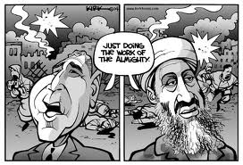

Marxism beyond Marx
Marx, then, regarded capitalism as fundamentally unfair and a corrupt way to organise society. He also abhorred nationalism and religious fundamentalism.
‘Marxism’ does not just refer, however, to the ideas generated by Marx himself, but to a huge body of work created by numerous academics, scholars and revolutionaries who have adopted Marx’s ideas...

Slide 14
Antonio Gramsci
One example of this is Antonio Gramsci (1891 – 1937). He was an Italian political theorist. A founding member and onetime leader of the Communist Party of Italy, he was imprisoned by Mussolini's Fascist regime.
He is renowned for his concept of cultural hegemony as a means of maintaining the state in a capitalist society.
Antonio Gramsci

Slide 15

Hegemony
Hegemony is the way in which those in power maintain their control.
Dominant ideologies are considered hegemonic; power in society is maintained by constructing ideologies which are usually promoted by the mass media.

Slide 16

Gramsci and Hegemony
In "advanced" industrial societies hegemonic cultural innovations such as compulsory schooling, the mass media, and popular culture have indoctrinated workers to a false consciousness.

Slide 17

Cultural hegemony
Cultural hegemony is the philosophic and sociological concept that a culturally-diverse society can be ruled or dominated by one of its social classes.
It is the dominance of one social group over another, e.g. the ruling class over all other classes.
The theory claims that the ideas of the ruling class come to be seen as the norm; they are seen as universal ideologies, perceived to benefit everyone whilst only really benefiting the ruling class.

Slide 18
Hegemony... in more detail
Hegemony dates to the Greek verb hegeisthai which translates to “to lead.” Early leaders who were able to exert a great deal of control and influence over a group of people might be referred to as hegemons. A hegemon had to have a great deal of support from at least one dominating class, in order to keep the people of the state from rebelling against the leadership.
Not only money, but also other forms of dominance can influence the hegemony of one group. For example, control of the media, up until recently, has influenced things like what shows get aired, what shows get cancelled, and the degree to which a television station must censor news or television shows.

Slide 19

Hegemony... in more detail
However, this hegemony of the publishing industry is in considerable flux given the many independent websites like YouTube.
Many musicians and actors are avoiding the media by self-publishing their music and videos on sites accessible to all. As the public decides to self-publish artistic works, or blogs, hegemony begins to shift to the people.
The people now arguably hold hegemony instead of the broadcasting companies. However, traditional broadcasting companies are attempting to regain hegemony by using these new technologies.

Slide 20
Hegemony in more detail
Hegemony tends to more often refer to the power of a single group in a society to essentially lead and dictate the other groups of the society. This may be done through communications, through influence of voters or of government leaders.
A single country may also be considered a hegemony if it has enough power to influence the way other countries behave. States that are hegemonies, like the British Empire in the mid-19th century, had extraordinary influence on many other countries. Their partial or total control of other countries was either obtained through a show of military force, and through control of trade industries.
Hegemony that exists in a single country means the dominant and most influential group often influences policy so that the greatest advantage accrues to the dominant group. For example, some consider the wealthy have hegemony in the US when it comes to tax laws.

Slide 21
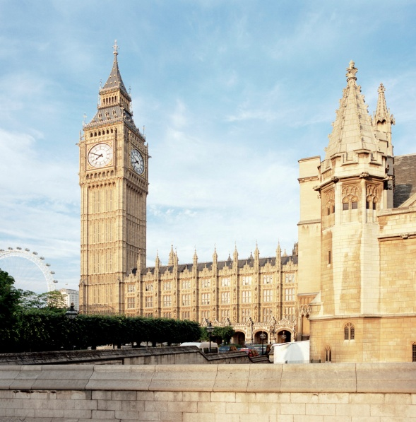
Optional extension:
We would describe our society as liberal pluralist. This is a very different ideological stand point from Marxism.
Activity
Research the term ‘liberal pluralist’ and then write a speech about liberal pluralism. You might start with the words:
In our society we believe ...
If you’re feeling brave enough you could deliver
your speech next lesson (but there will be
no requirement to do this.)

