Slide 1
Testing of Hypothesis
Dr. Shaji Mara,m Veettil
Associate Professor & Head
RSM SNDP Yogam College, Koyilandy

Slide 2
Basic Concepts
Population: In statistics, ‘Population’ refers to collection of all individuals or objects or items or things under consideration.
Finite Population: If a population contains a finite number of objects, it is called finite population. Eg: Students in a college.
Infinite Population: If a population contains a infinite number of objects, it is called infinite population. Eg: Stars in the sky.
Sample: A sample is a representative part of the population.
Sample size: Number of units in a sample group is called sample size. If sample size is too small, it may not represent the population. If it is very large, it may require more time and money for investigation. Hence, the size of a sample should be optimum

Slide 3
Large Sample: If the size of a sample exceeds thirty, it is called as large sample.
Small Sample: If the size of a sample does not exceed thirty, it is called as small sample.
Parameter: It is a statistical measure derived from population elements. If the arithmetic mean is computed from all the elements of a population, it is a population parameter. Here it is called population mean. Population mean is denoted by the symbol μ. Population standard deviation is denoted by σ.
Statistic: It is a statistical measure derived from sample elements. If the arithmetic mean is computed from the elements of a sample group, it is a sample statistic. Here it s called sample mean. Sample mean is denoted by the symbol x̄. Sample standard deviation is denoted by ‘s’.

Slide 4
Statistical inference : Statistical inference refers to the process of selecting samples and using sample statistic to draw inference or conclusion about the population parameter or population distribution.
The two main branches of statistical inference are:
    (a) Testing of Hypothesis
    (b) Estimation

Slide 5
Testing of Hypothesis
Testing of hypothesis is the process under which a statistical hypothesis about a population is formulated and its validity is tested on the basis of a random sample drawn from that population.
For testing the validity of a hypothesis, a number of tests are used. All these tests can be classified into two categories, namely,
    (i) parametric tests and
    (ii) non-parametric tests.
Z-test, t-test, Chi-square test, F-test, etc. are commonly used statistical tests.

Slide 6
Hypothesis
Hypothesis is a tentative solution or assumption or proposition about the parameter or nature of the population.
It is a logically drawn conclusion about the population.
Null Hypothesis : This is the original hypothesis. A null hypothesis is a hypothesis which is formulated for the purpose of rejection. The term “null” refers to ‘nil’ or ‘no’ or‘amounting to nothing’.
This hypothesis is generally set up as there is no significant difference between the sample statistic and population parameter.
A null hypothesis is denoted by H₀

Slide 7
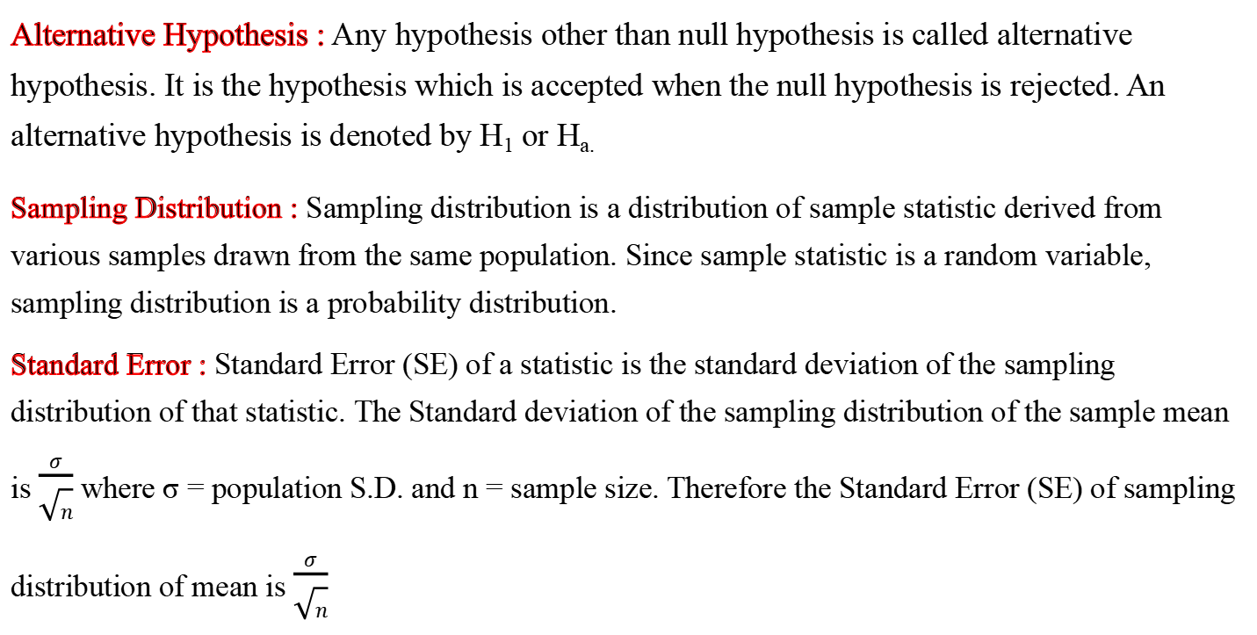
Alternative Hypothesis : Any hypothesis other than null hypothesis is called alternative hypothesis. It is the hypothesis which is accepted when the null hypothesis is rejected. An alternative hypothesis is denoted by H₁ or H_{a.}
Sampling Distribution : Sampling distribution is a distribution of sample statistic derived from various samples drawn from the same population. Since sample statistic is a random variable, sampling distribution is a probability distribution.
Standard Error : Standard Error (SE) of a statistic is the standard deviation of the sampling distribution of that statistic. The Standard deviation of the sampling distribution of the sample mean is $\frac{σ}{\sqrt{n}}$ where σ = population S.D. and n = sample size. Therefore the Standard Error (SE) of sampling distribution of mean is $\frac{σ}{\sqrt{n}}$

Slide 8
Uses of Standard Error
Standard Error is used for testing a given hypothesis.
Standard Error gives an idea about the reliability of a sample. The reciprocal of Standard Error is a measure of reliability of the sample.
Standard Error can be used to determine the confidence limits for population values like mean, proportion and standard deviation.

Slide 9
Errors in Testing of Hypotheses
In any test of hypothesis, the decision is to accept or to reject a null hypothesis. The decision is based on the information supplied by the sample data. The four possibilities of the decision are:
  Accepting a null hypothesis when it is true
  Rejecting a null hypothesis when it is false
  Rejecting a null hypothesis when it is true
  Accepting a null hypothesis when it is false
It is clear that the possibilities (1) and (2) are correct decisions. But the possibilities (3) and (4) are errors.
Type I Error: The error which is committed by rejecting the null hypothesis even when it is true is called Type I error. It is denoted by alpha (α).
Type II Error: The error which is committed by accepting the null hypothesis even when it is wrong is called Type II error. It is denoted by beta (β).
  When we try to reduce the possibility for one error, the possibility for the other will be increased.
  Therefore, a compromise of these two is to be ensured. Type II error is more dangerous than Type I error.

Slide 10
Power of a Test : Probability for rejecting the null hypothesis when the alternative hypothesis is true is called power of a test.
Power of a test = 1 – P(Type II Error)
Level of Confidence :
  Level of confidence is the probability of accepting a true null hypothesis.
Level of Confidence = 1 – Level of significance.
If Level of significance is 5%, Level of Confidence = 95%.
Level of Significance :
  Level of Significance is the probability of rejecting a true null hypothesis.
  Level of Significance is denoted by alpha (α).
  If nothing is mentioned about the level of significance, it is taken as 5%.
Level of Significance (α) = 1 – level of acceptance

Slide 11
Acceptance Region
  The area under the normal curve which represents the acceptance of a null hypothesis (i.e; level of confidence) is called the Acceptance Region or Acceptance Area.
  Acceptance Region = 100% -- Rejection Region
Rejection Region (Critical Region)
  The area under the normal curve which represents the rejection of a null hypothesis (i.e; level of significance) is called the Rejection Region or Critical Region.
  Rejection Region = 100% -- Acceptance region

Slide 12
Degree of Freedom
  Degree of freedom is defined as the number of independent observations which is obtained by subtracting the number of constraints from the total number of observations.
  Degree of freedom (d.f) = Total No. observations – No. of constraints.

Slide 13
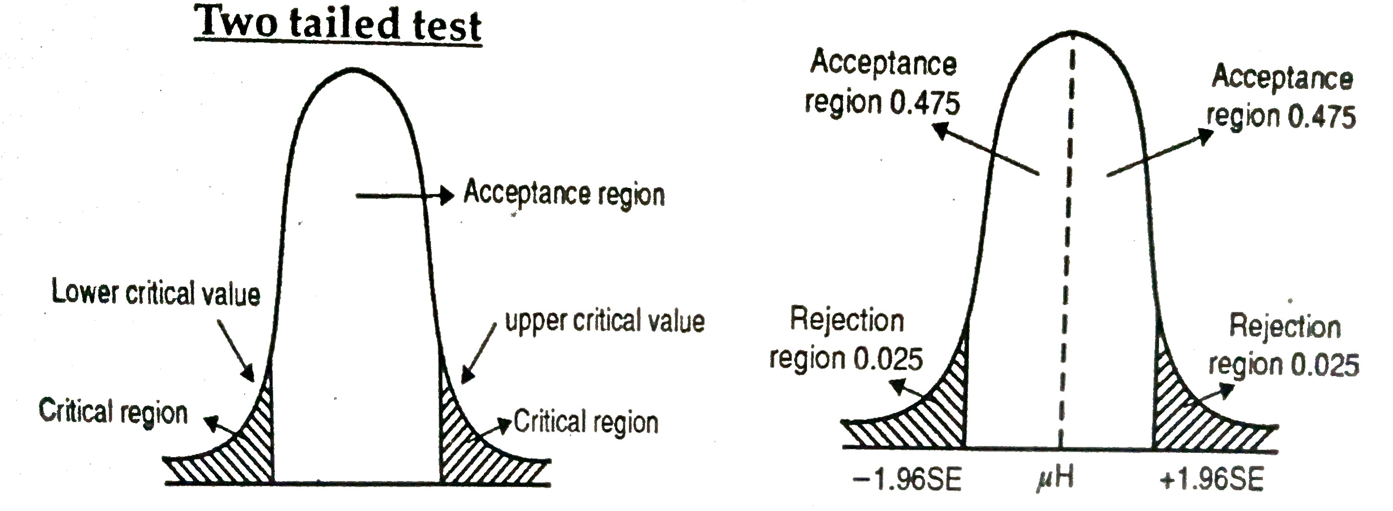
Two-tailed Test
A two tailed test is one in which we reject the null hypothesis if the computed value of the test statistic is significantly greater than or lower than the critical value (table value) of the test statistic.
Thus in two tailed tests the critical region is represented by both tails.
If we test the hypothesis at 5% level of significance, the size of the acceptance region is 95% and the size of the rejection region is 5% on both sides together.

Slide 14
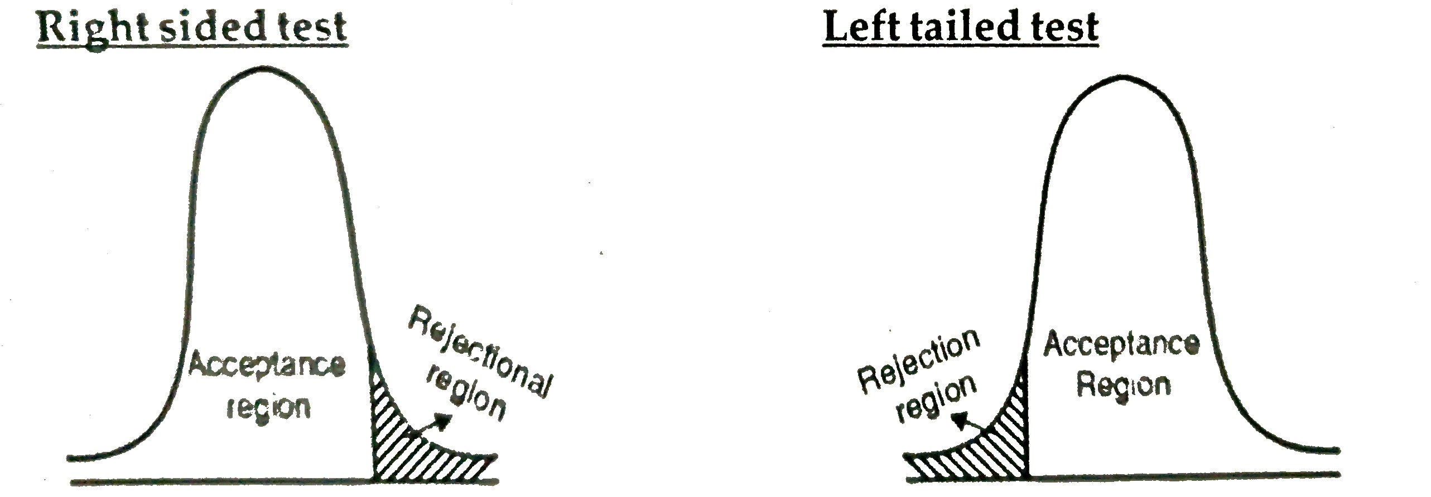
One-tailed Test
One tailed test is one in which the rejection region is located in only one tail of the normal curve.
It may be at left tail or right tail, depending on the alternative hypothesis. If the alternative hypothesis is with ‘<’ (less than) sign, the rejection region is placed on the left tail, and the test is called left tailed test.
If the alternative hypothesis is with ‘>’ (more than) sign, the rejection region is placed on the right tail, and the test is called right-tailed test.

Slide 15
Critical Value (Table Value)
The critical value is the value of the test statistic which separates the rejection region from the acceptance region.
It depends on the level of significance and degree of freedom. When the calculated value of the test statistic is numerically less than the critical value, the null hypothesis is accepted.
When the calculated value of the test statistic is numerically more than the critical value, the null hypothesis is rejected.
Parametric Tests
When testing of hypothesis is done, if some assumptions are made about the nature of population distribution, then the test statistic applied there is called parametric test.
There are number of parametric tests. Eg: t-test, Z test, F test, etc.
Non-Parametric Tests
When testing of hypothesis is done, if no assumptions are made about the nature of population distribution, then the test statistic applied there is called non-parametric test.
There are number of non-parametric tests. Eg: Chi-square Test, Sign tests, Signed Rank Tests, Rank Sum Tests, Run Test, Kolmogrov Smirnov Test, etc. Since, no assumptions are made about the nature of population, non-parametric tests are also called distribution-free tests.

Slide 16
Procedure for testing hypothesis
Set up null hypothesis and alternative hypothesis
Decide the test statistic (statistical test) applicable for testing hypothesis.
Apply the appropriate formulae for computing the value of the test statistic.
Specify the level of significance. If nothing is mentioned about the level of significance, take 5% level o significance.
Fix the degree of freedom
Locate the table value (critical value) of the test statistic at specified level of significance
Compare the calculated value of the test statistic with the corresponding table value (critical value) and decide whether to accept or reject the null hypothesis. If calculated value of the test statistic is numerically less than the table value, the null hypothesis is accepted. If calculated value of the test statistic is numerically more than the table value, the null hypothesis is rejected.

Slide 17
Central Limit Theorem
In the study of probability theory, the central limit theorem (CLT) states that the distribution of sample approximates a normal distribution as the sample size becomes larger, assuming that all samples are identical in size, and regardless of the population distribution shape.
A key aspect of CLT is that the average of the sample means and standard deviations will equal the population mean and standard deviation.
A sufficiently large sample size can predict the characteristics of a population accurately.

Slide 18
Z-Test
Z-test is a statistical test used to compare a sample mean to a known population mean (μ) to determine whether the sample mean is statistically or significantly different from the population mean.
To use the Z-Test, a sample must be drawn from a population with a known mean (μ) and standard deviation (σ).
The Z-Test calculates a Z-Score for the sample mean with respect to the population mean.
The greater the difference between the sample mean and the population mean, the larger the Z-Score and the less likely the sample is associated with the population.

Slide 19
Steps
Running a Z test requires five steps:
  State the null hypothesis and alternate hypothesis.
  Choose an alpha level.
  Find the critical value of z in a z table.
  Calculate the z test statistic .
  Compare the test statistic to the critical z value and decide if you should support or reject the null hypothesis.

Slide 20
Uses of Z test
To test the population mean when the sample size is large (more than 30) or when standard deviation of population is known.
To test the equality of two sample means when the sample size are large or when the population standard deviation is given.
For testing the population proportion.
For testing the equality of two population proportions.
For testing the population standard deviation when the sample size is large.
For testing the equality of two sample standard deviations when the sample size are large or when population standard deviations are known.
For testing the equality of correlation coefficients.

Slide 21
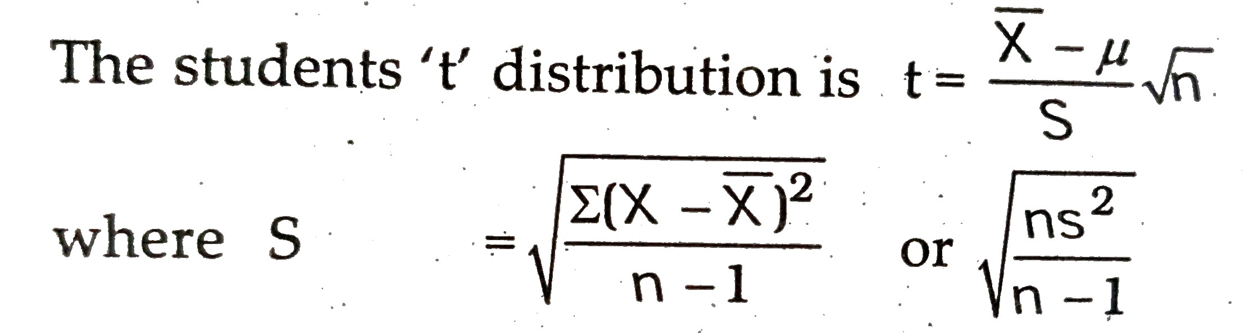
Student’s t - test
Student’s t–test in statistics is a method of testing the hypothesis about the mean of a small sample drawn from a normally distributed population when the population standard deviation is unknown.
This distribution was developed by an Irish statistician S.Gosset .
The distribution developed by Gosset written under his pen name Student and has come to be known as Student’s t- distribution in 1908.
This distribution should be used when the sample size is less than 30.
S = Estimated Standard deviation of the population

Slide 22
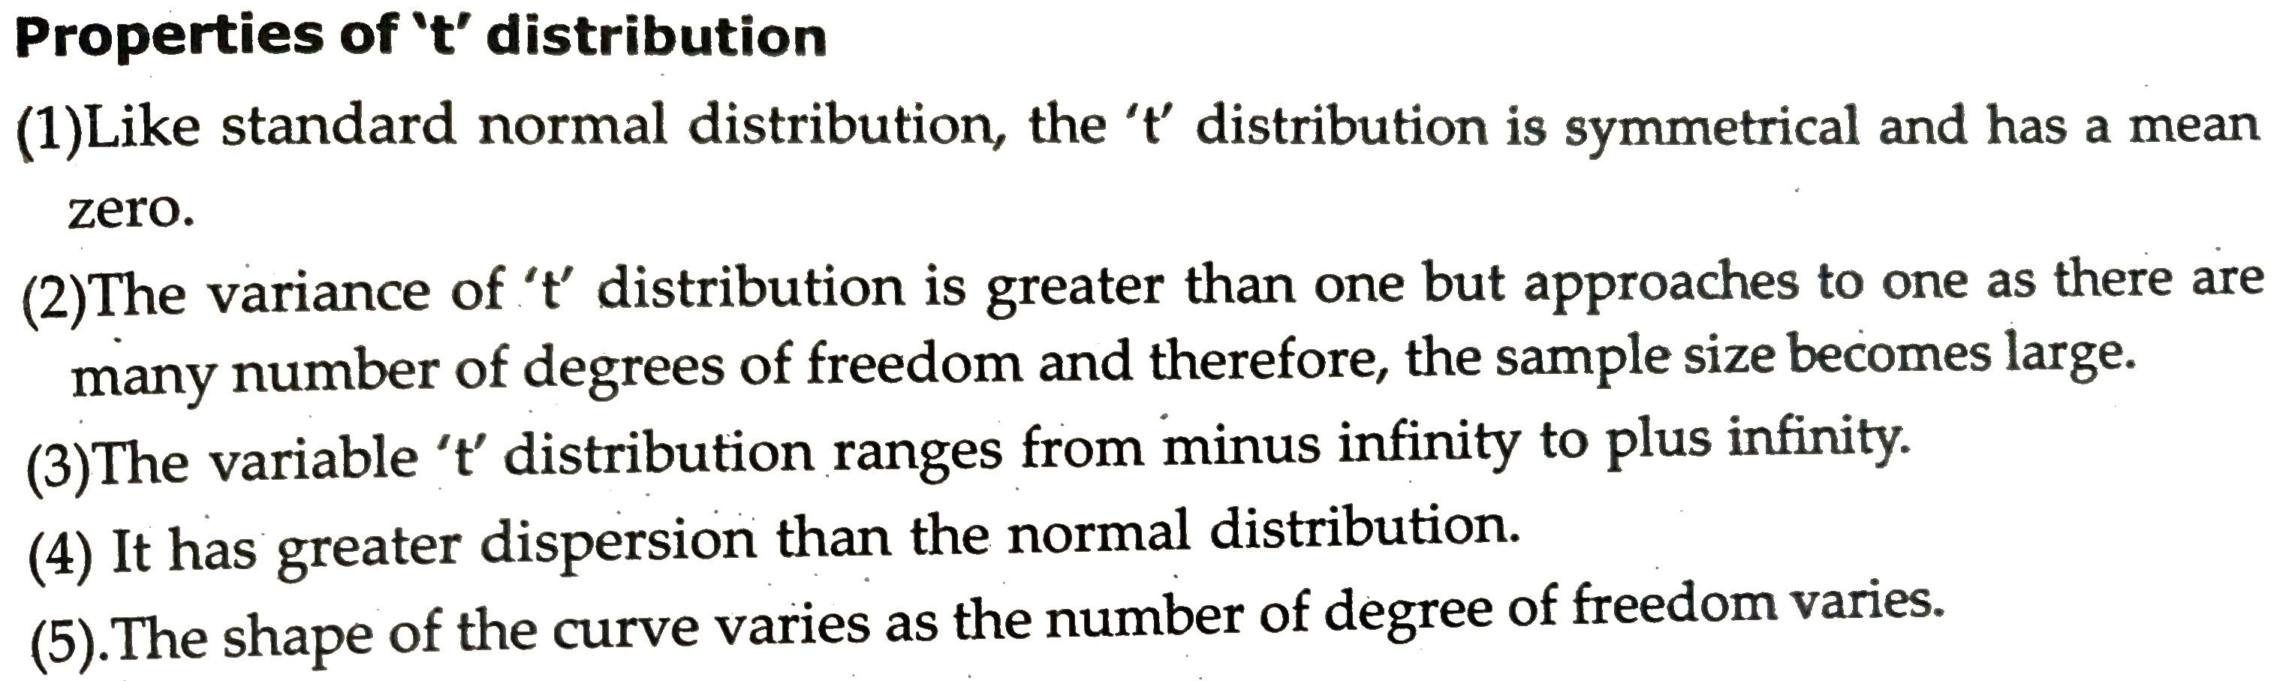

Slide 23
