Slide 1
Camera Shots And Angles

Slide 2
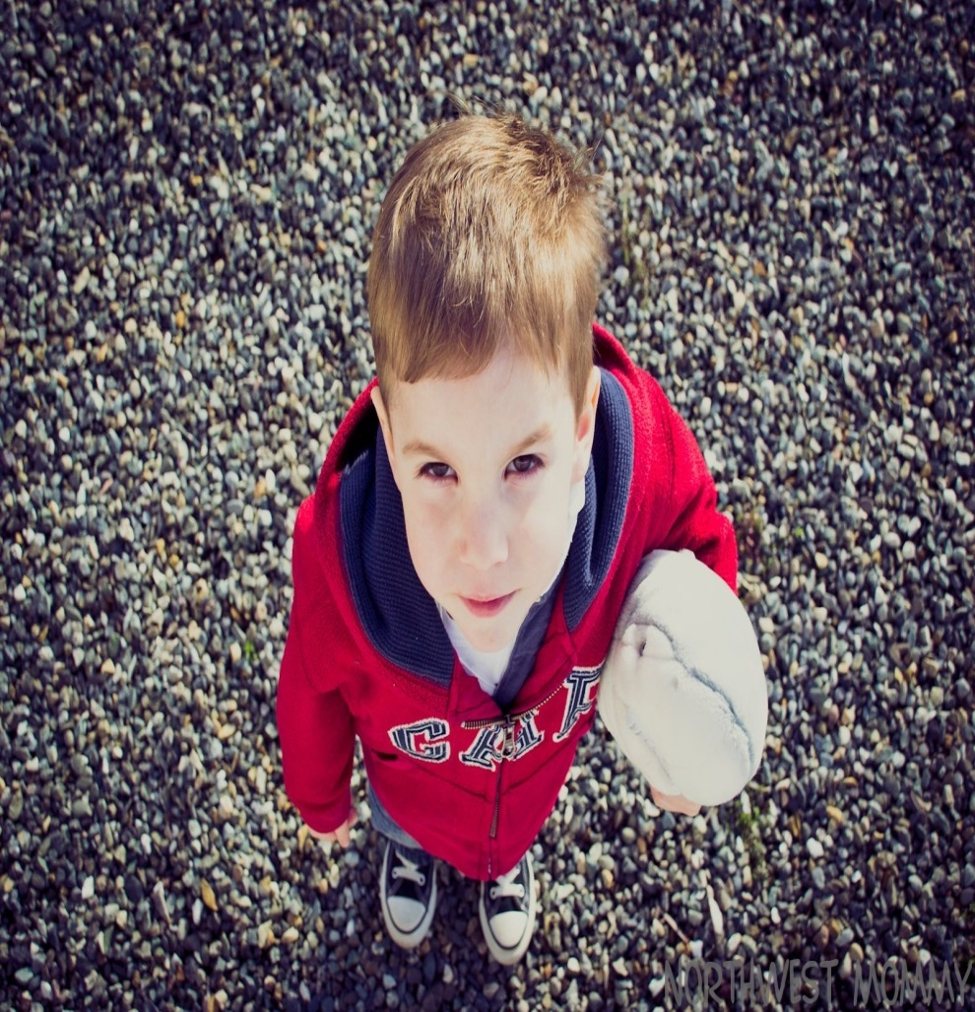
High Angle
This angle looks down on someone, It makes the object or person in the picture look small and insignificant. This is commonly used in TV dramas when they want you to know someone has more power than someone else.

Slide 3
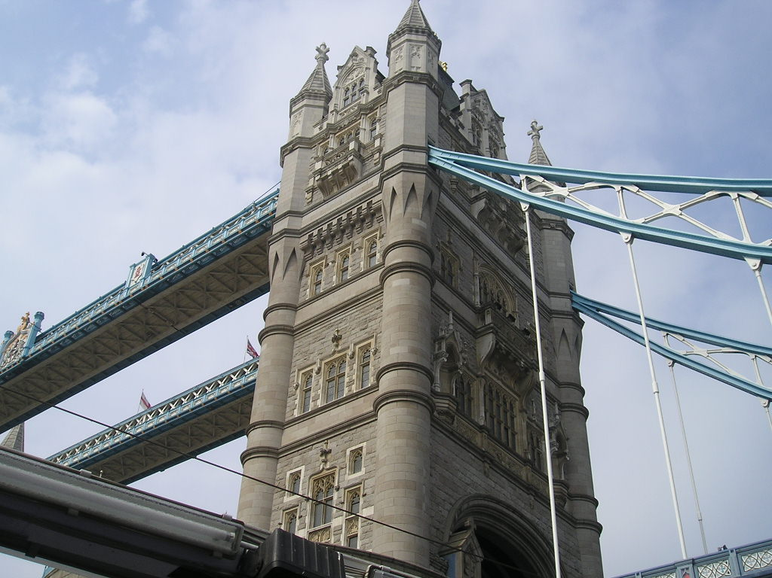
Low Angle
This angle looks up on something or someone making it look bigger than it actual is. It opposite of a high angle it is commonly used when they want to make someone look big and powerful.

Slide 4
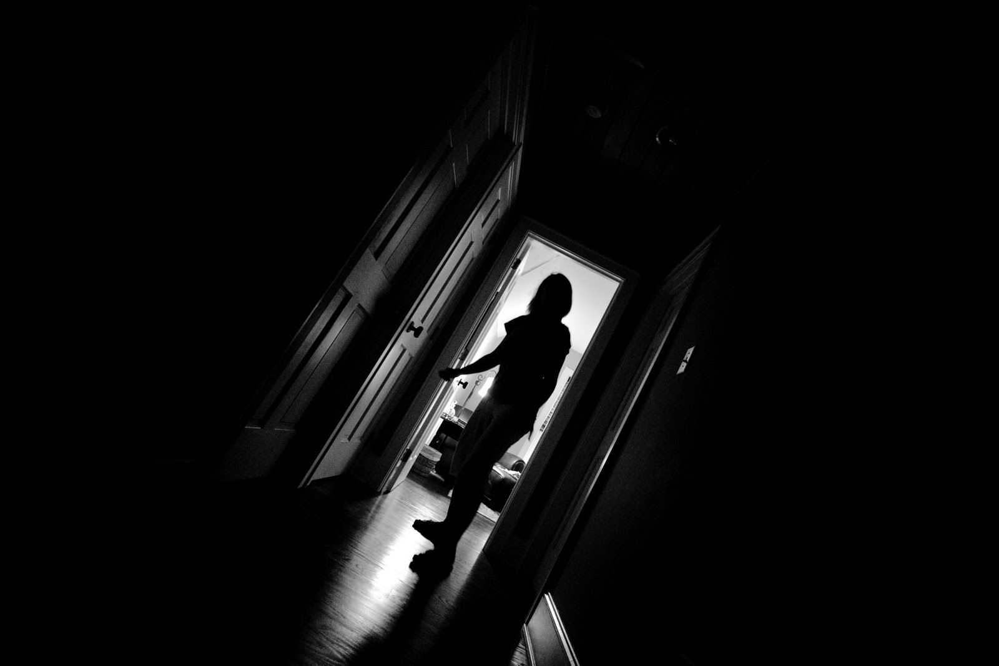
Slanted Angle
A slanted angle shows and object or someone from an unnatural point of view. It can be used in dramas to show things only the audience can see.

Slide 5
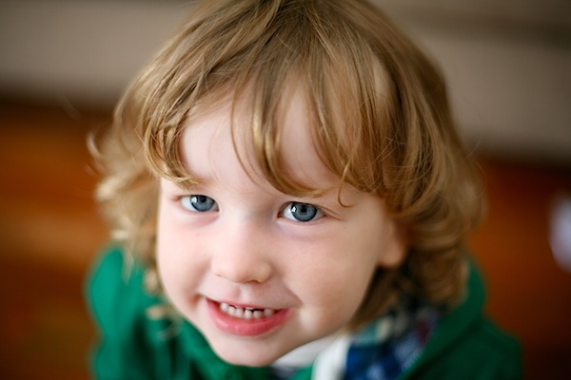
Eye Level Angle
The eye level angle shows the object of a picture looking directly at you, this shows the he or she has the same amount of power as you. Sometimes it is also used to show emotion on a persons face

Slide 6
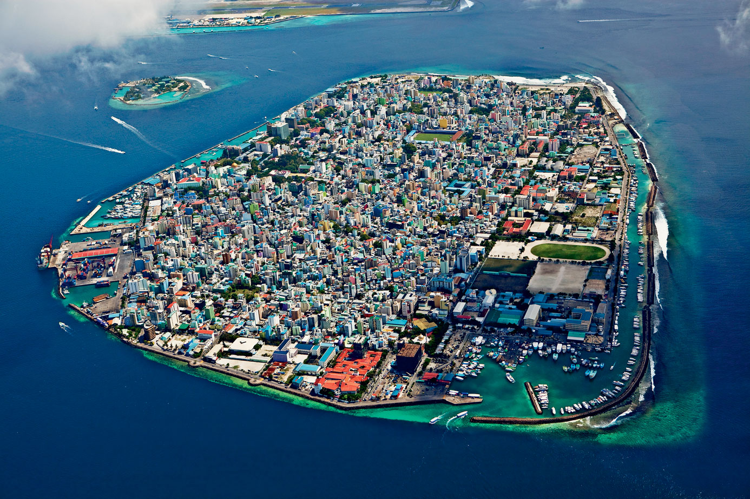
Aerial Shot
A view from above, it shows everything that happens from a birds eye view. It shows the audience everything that is happening at one time.

Slide 7

Close Up Shot
Close up shots are used to show things in such detail that is blurs the background around the image.
However it can also be used in drama and film to get close to the actors so that the audience feels involved in what is happening.

Slide 8
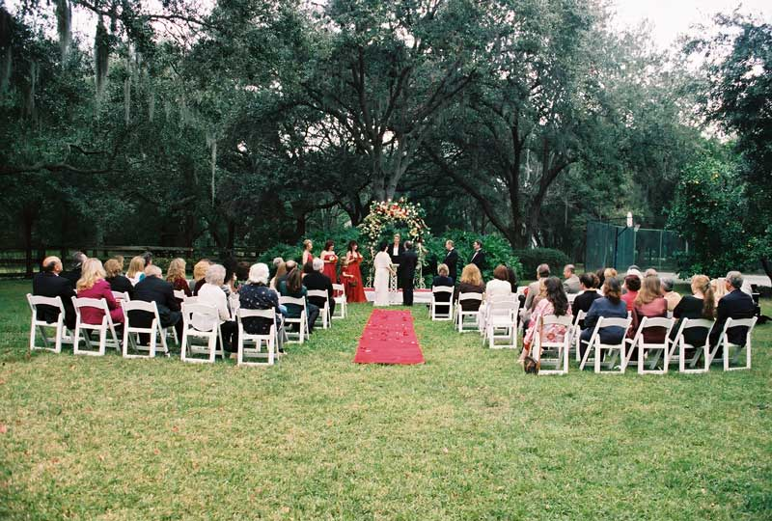
Long Shot
This shot is usually taken form a distance, it shows a whole setting. It could be used to show a whole scenario or an actors full body.

Slide 9
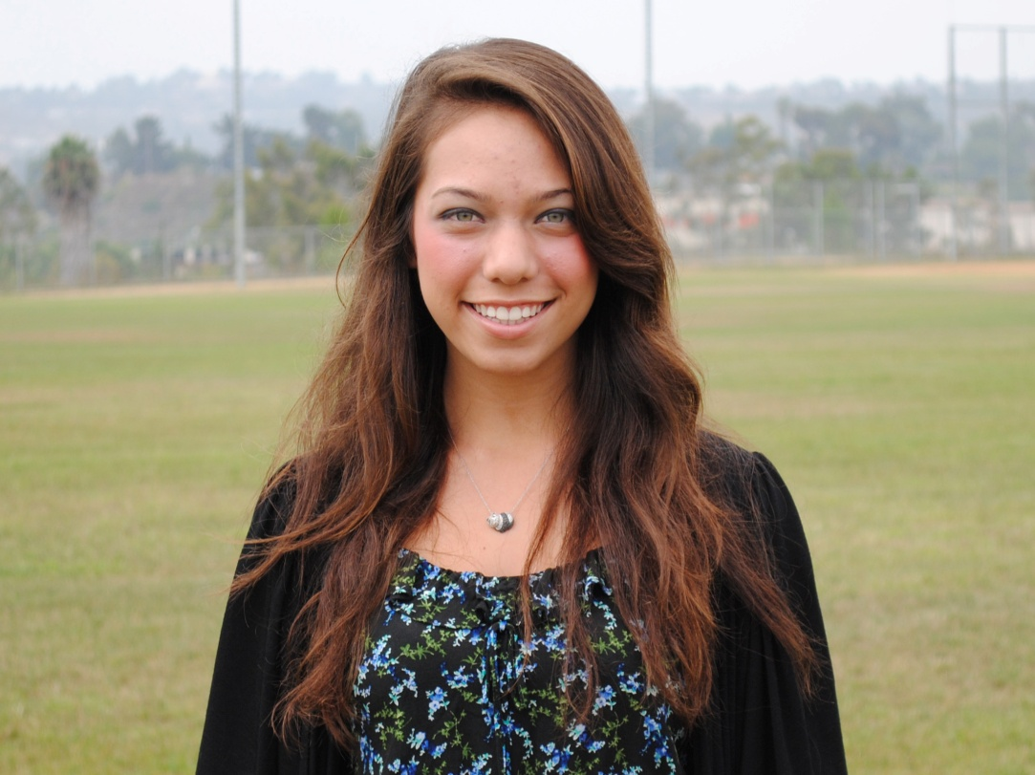
Medium Shot
A medium shot is usually form the models head down to his or his torso or even above. This is to show the models head as well as their body. This shot is usually used on magazine covers

Slide 10
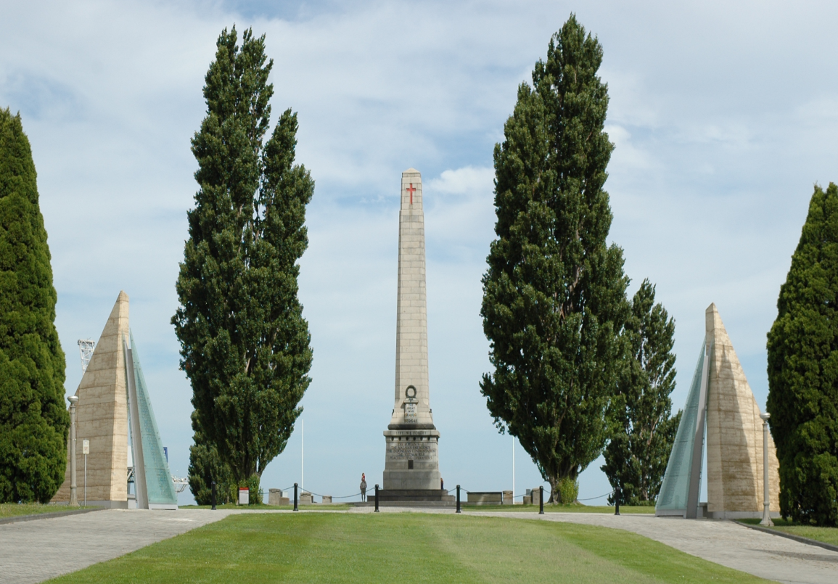
Wide Shot
This shot is commonly used to show a model and a large setting behind them. The main point of this shot is to show the background more than the model. Moreover it also used to show large distances.

Slide 11
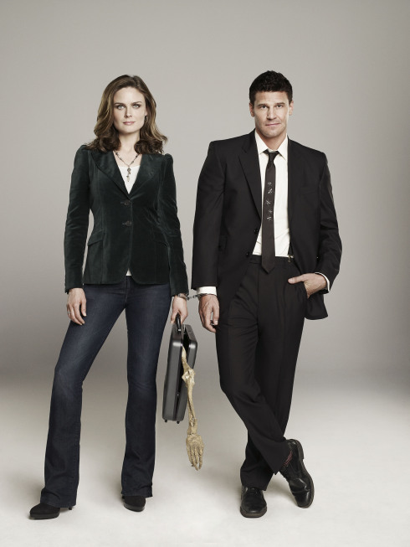
Two Shot
Two shot is a shot with two people in it. It is usually used to show a relationship like friends or a couple.

Slide 12
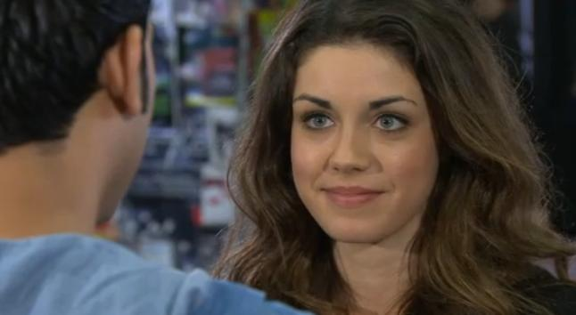
Over The Shoulder
Taken from behind a subject to show someone else it is sometimes used in dramas to show a persons facial expression but this is most commonly used to show when two people are having a conversation.

Slide 13
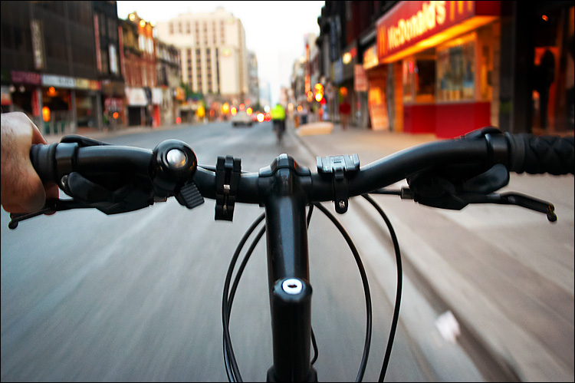
Point Of View
This shows a viewpoint of an actor. You van usually see the actors hand and feet so you know straight away what sort of shot this is it is also used in movies to show when someone's eyesight gets blurry.

