Slide 1
CATALYSIS
Topic:Michaelis Menten Mechanism
Dr. AMPILY J S

Slide 2
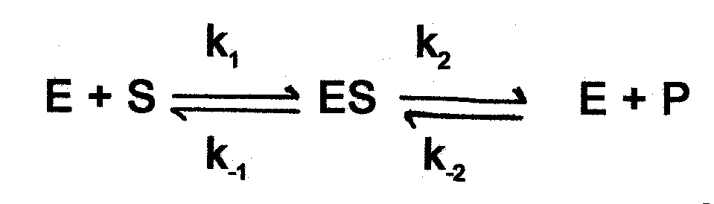
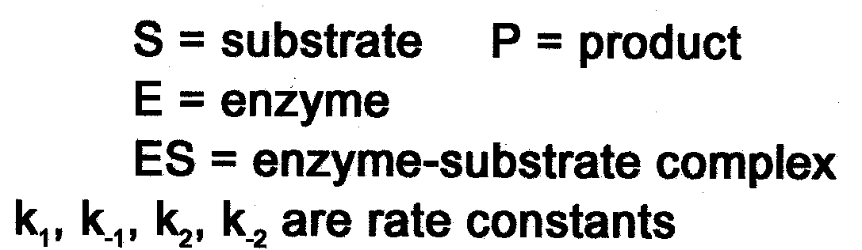
Enzyme Kinetics Equation

Slide 3
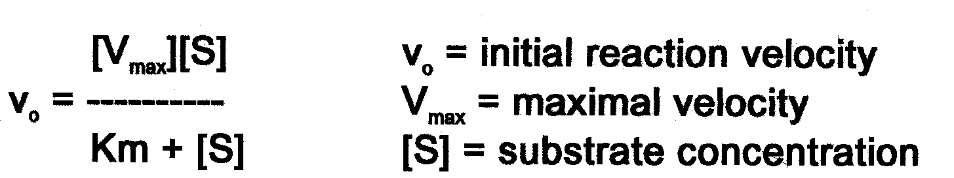
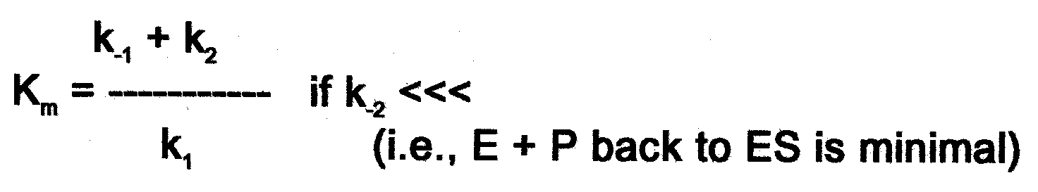
Michaelis-Menten Equation

Slide 4
Initial Velocity (v_{o}) and [S]
The concentration of substrate [S] present will greatly influence the rate of product formation, termed the velocity (v) of a reaction. Studying the effects of [S] on the velocity of a reaction is complicated by the reversibility of enzyme reactions, e.g. conversion of product back to substrate.
To overcome this problem, the use of initial velocity (v_{o}) measurements are used. At the start of a reaction, [S] is in large excess of [P], thus the initial velocity of the reaction will be dependent on substrate concentration

Slide 5
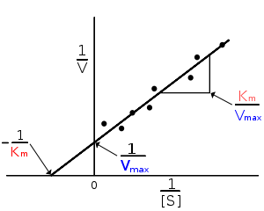
Lineweaver – Burk Double Reciprocal Plots
The Michaelis-Menten equation can be recast into a linear form
To obtain parameters of interest
Reciprocal form of equation
1 = Km 1 + 1
V V_{max} S V_{max}
Y= m x + b
The y-intercept gives the V_{max} value and the slope gives K_{m}/V_{max}
Vmax is determined by the point where the line crosses the 1/Vi = 0 axis (so the [S] is infinite).
K_{m} equals V_{max} times the slope of line. This is easily determined from the intercept on the X axis.

Slide 6
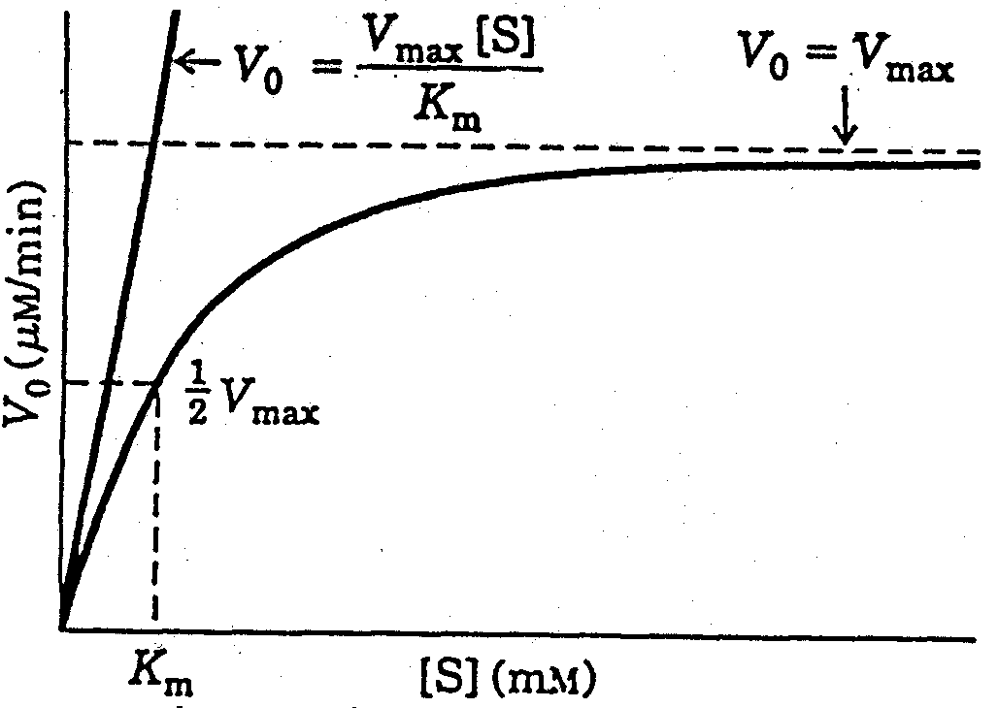
Michaelis-Menten Curve

Slide 7
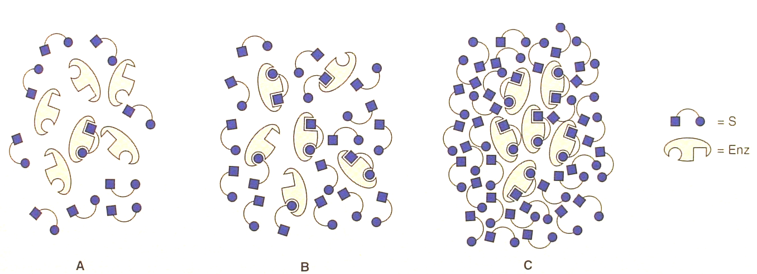
Substrate Saturation of an Enzyme
A. Low [S] B. 50% [S] or K_{m} C. High, saturating [S]

Slide 8
Steady State Assumption
The M-M equation was derived in part by making several assumptions. An important one was: the concentration of substrate must be much greater than the enzyme concentration.
In the situation where [S] >> [E] and at initial velocity rates, it is assumed that the changes in the concentration of the intermediate ES complex are very small over time (v_{o}). This condition is termed a steady-state rate, and is referred to as steady-state kinetics. Therefore, it follows that the rate of ES formation will be equal to the rate ES breakdown.

Slide 9
Michaelis-Menten Equation Derivation
Rate of ES formation = k₁([E_{T}] - [ES])[S] (where [E_{T}] is total concentration of enzyme E and k₋₂ is considered neglible)
Rate of ES breakdown to product = k₋₁[ES] + k₂[ES]

Slide 10
Michaelis-Menten Equation Derivation
Thus for the steady state assumption:
k₁([E_{T}] - [ES])[S] = k₋₁[ES] + k₂[ES]
This equation is the basis for the final Michaelis-Menten following algebraic rearrangement and substitution of K_{m} and V_{max} terms.

Slide 11
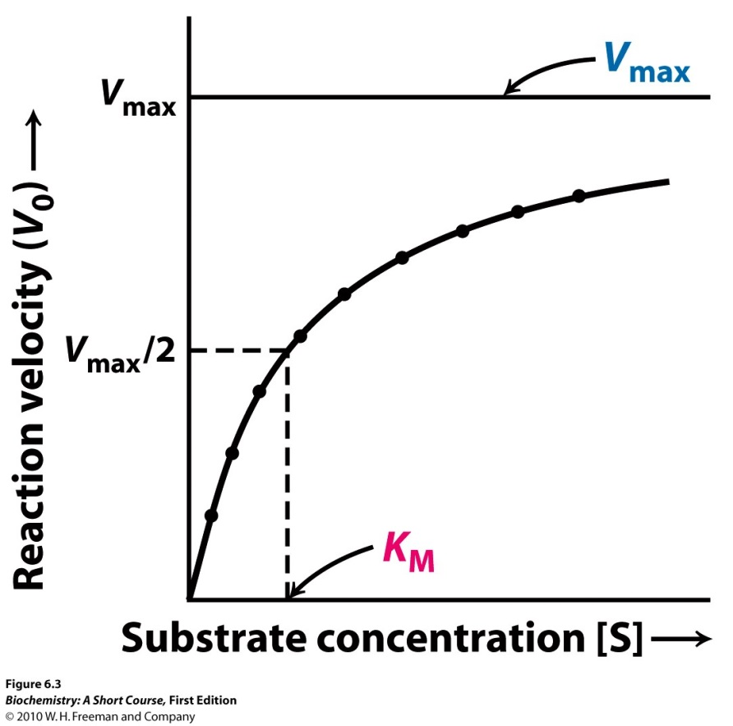
V_{max} and K_{m}
V₀ = V_{max}
[S]
[S]+K_{m}
K_{m}=
k-1 + k2
k1
When V₀=V_{max,} K_{m}= [S]
Km is unique to each Enzyme and Substrate. It describes properties of enzyme-substrate interactions
Independent of enzyme conc. Dependent on temp, pH etc.
Vmax is maximal velocity POSSIBLE. It is directly dependent on enzyme conc. It is attained when all of the enzyme binds the substrate. (Since these are equilibrium reactions enzymes tend towards Vmax at high substrate conc but Vmax is never achieved. So it is difficult to measure).
When an enzyme is operating at Vmax, all enzyme is bound to substrate and adding more substrate will not change rate of reaction (enzyme is saturated). (adding more enzyme will change the reaction).

Slide 12

Important Conclusions of Michaels - Menten Kinetics
when [S]= K_{M}, the equation reduces to
when [S] >> K_{M}, the equation reduces to
when [S] << K_{M}, the equation reduces to

Slide 13
Measuring Km and Vmax
Vmax
1/vo
vo
1/Vmax
[Substrate]
-1/Km
1/[S]
You can use a curve fitting algorithm to determine Km and Vmax from a V vs [S] plot (need a computer)
Reaction rates are initial rates determined when the substrate is in vast excess and isn’t changing much.
Alternatively you can convert the curve to a straight line via a double reciprocal plot (1/Vmax and 1/[S])

Slide 14
Significance of Km and Vmax
Km is [S] at 1/2 Vmax
It is a constant for a given enzyme at a particular temp and pressure
It is an estimate of equilibrium constant for substrate binding to enzyme
Small Km= tight binding, large Km=weak binding
It is a measure of substrate concentration required for effective catalysis
Vmax is THEORETICAL MAXIMAL VELOCITY
Vmax is constant for a given enzyme
To reach Vmax, ALL enzyme molecules have to be bound by substrate
Kcat is a measure of catalytic activity- direct measure of production of product under saturating conditions.
Kcat is turnover number- number of substrate molecules converted to product per enzyme molecule per unit time
Catalytic efficiency = kcat/km
Allows comparison of effectiveness of an enzyme for different substrates

Slide 15
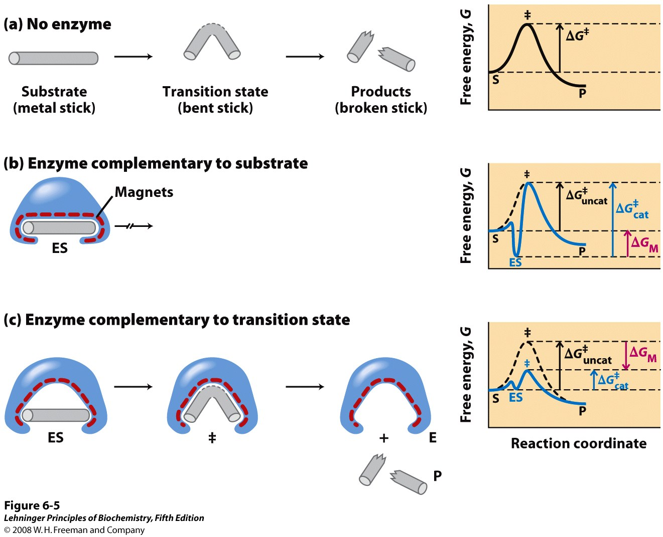
A Hypothetical reaction
Notes:
15
FIGURE 6-5 An imaginary enzyme (stickase) designed to catalyze breakage of a metal stick. (a) Before the stick is broken, it must first be bent (the transition state). In both stickase examples, magnetic interactions take the place of weak bonding interactions between enzyme and substrate. (b) A stickase with a magnet-lined pocket complementary in structure to the stick (the substrate) stabilizes the substrate. Bending is impeded by the magnetic attraction between stick and stickase. (c) An enzyme with a pocket complementary to the reaction transition state helps to destabilize the stick, contributing to catalysis of the reaction. The binding energy of the magnetic interactions compensates for the increase in free energy required to bend the stick. Reaction coordinate diagrams (right) show the energy consequences of complementarity to substrate versus complementarity to transition state (EP complexes are omitted). ΔG_{M}, the difference between the transition-state energies of the uncatalyzed and catalyzed reactions, is contributed by the magnetic interactions between the stick and stickase. When the enzyme is complementary to the substrate (b), the ES complex is more stable and has less free energy in the ground state than substrate alone. The result is an increase in the activation energy.

Slide 16
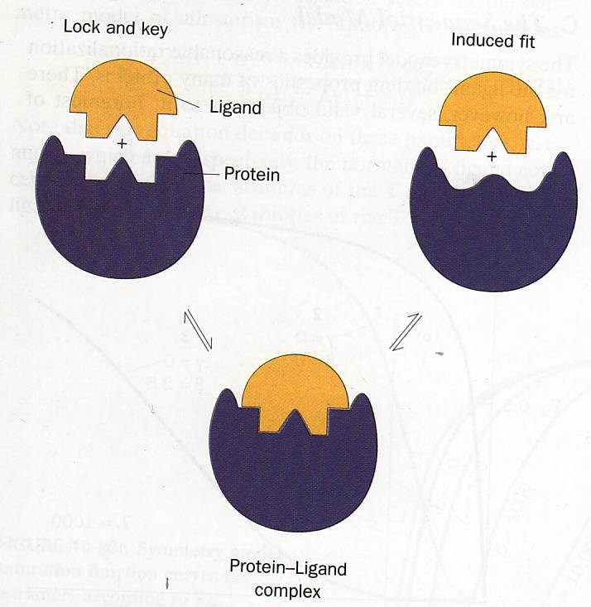
Lock/Key or Induced Fit

Slide 17
Enzyme Inhibition
S
P
S
P
E
E
E
E
E
E + S
ES
EP
E + P

Slide 18
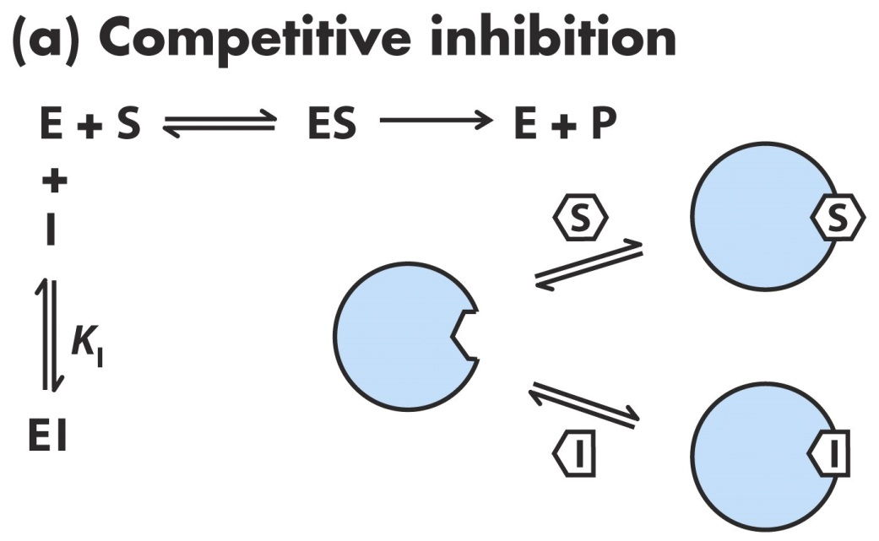
Competitive Inhibition
Vmax
-Inh
+inh
vo
1/2 Vmax
Km
Km
(app)
[Substrate]
Inhibitor competes with substrates for binding to active site
Inhibitor is similar in structure to substrate, binds more strongly, reacts more slowly
Increasing [I] increases [EI] and reduces [E] that is available for substrate binding
Need to constantly keep [I] high for effective inhibition (cannot be metabolized away in body)
Slope is larger (multiplied by α)
Intercept does not change (V_{max} is the same)
K_{M} is larger (multiplied by α)
1/v
+Inh
-Inh
1/Vmax
-1/Km
-1/Km (app)
1/[S]

Slide 19
Competitive Inhibition
Unimolecular
Reaction
Bimolecular
Reaction

Slide 20
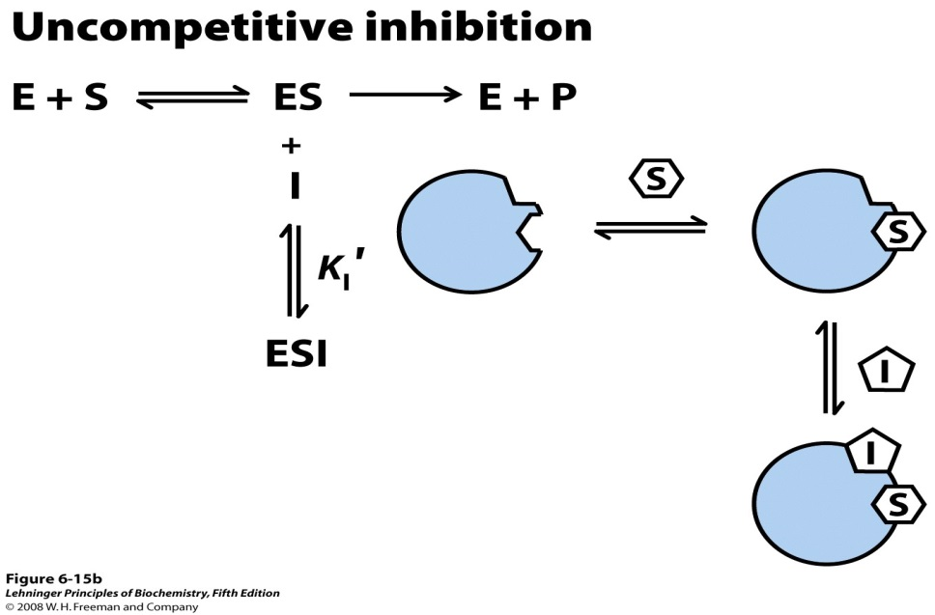
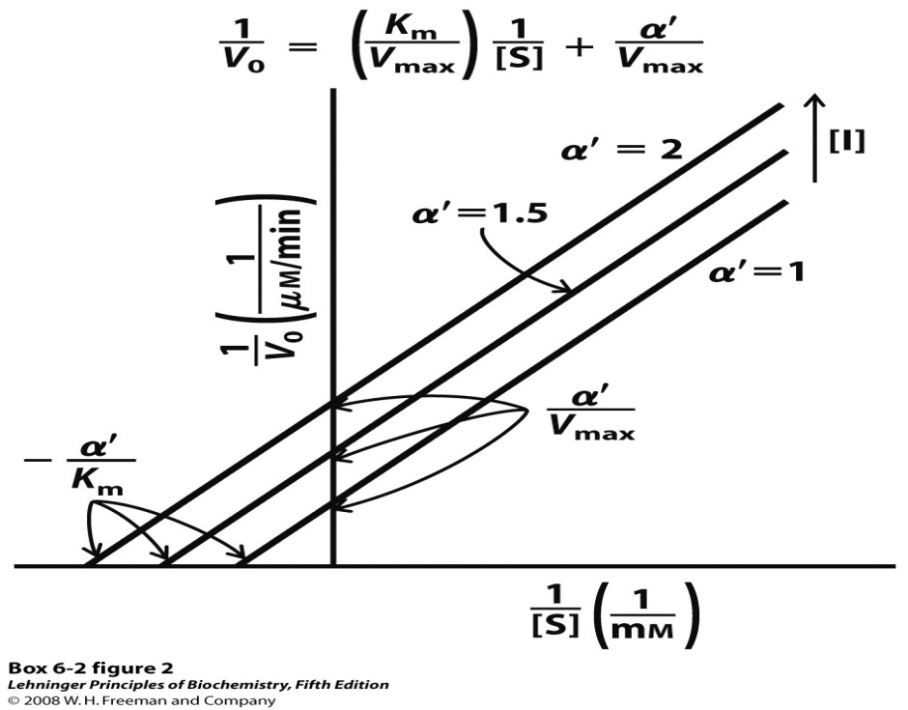
Uncompetitive Inhibition
Binds only to ES complex but not free enzyme
Binds at location other than active site
Does not look like substrate. Binding of inhibitor distorts active site thus preventing substrate binding and catalysis
Cannot be competed away by increasing conc of substrate (Vmax is affected by [I])
Increasing [I] lowers Vmax and lowers Km.
Increasing [I]
  Lowers V_{max} (y-intercept increases)
  Lowers K_{M} (x-intercept decreases)
  Ratio of K_{M}/V_{max} is the same (slope)

Slide 21
Uncompetitive Inhibition

Slide 22
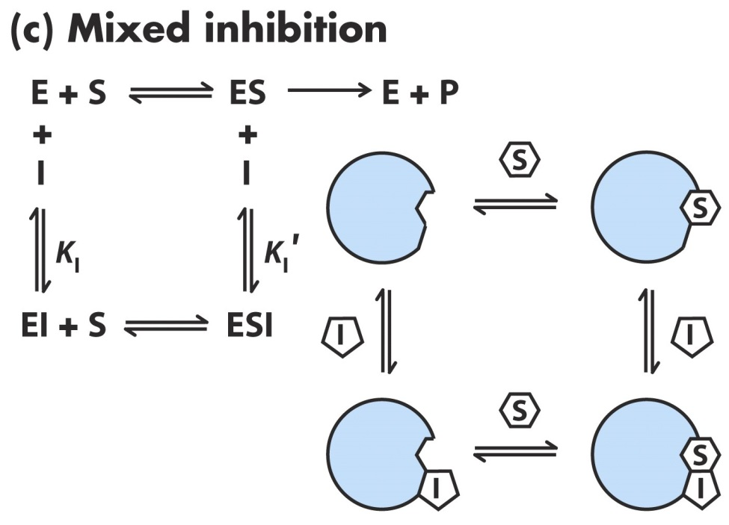
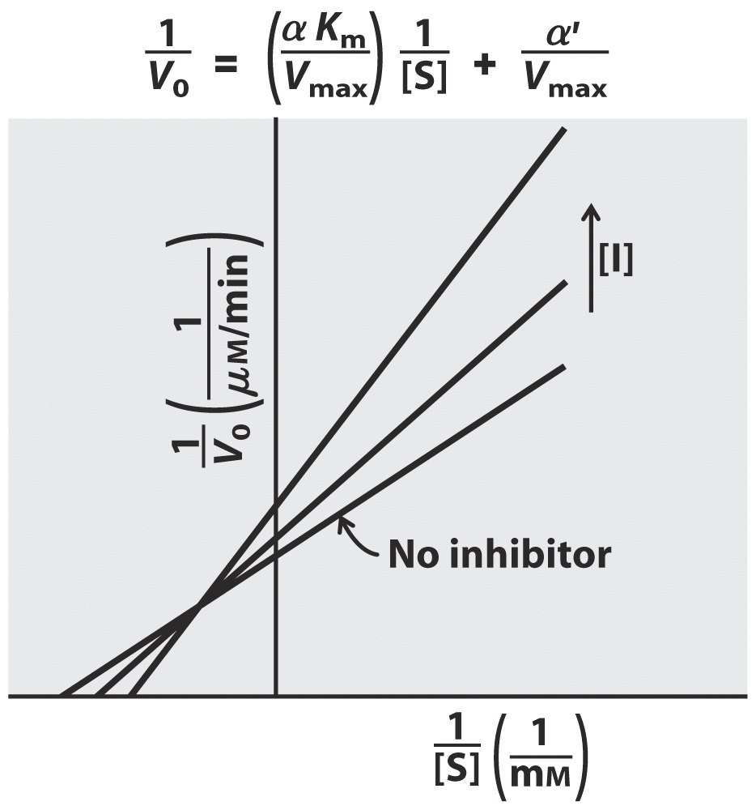
Mixed or Non Competitive Inhibition
Inhibitor binds E or ES
Increasing [I]
  Lowers V_{max} (y-intercept increases)
  Raises K_{M} (x-intercept increases)
  Ratio of K_{M}/V_{max} is not the same (slope changes)

Slide 23
Reversible Inhibition (non-competitive)
A inhibitor binds the enzyme but not in its active site. It affects the Kcat because substrate can still bind the active site.
Rate of catalysis is affected
+Inh
Vmax
1/v
-Inh
1/Vmax
(app)
-Inh
Vmax
(app)_
+inh
vo
1/2 Vmax
1/2 Vmax
(app)
1/Vmax
-1/Km
1/[S]
Km
Km
(app)
[Substrate]
Vmax is decreased proportional to inhibitor conc

Slide 24
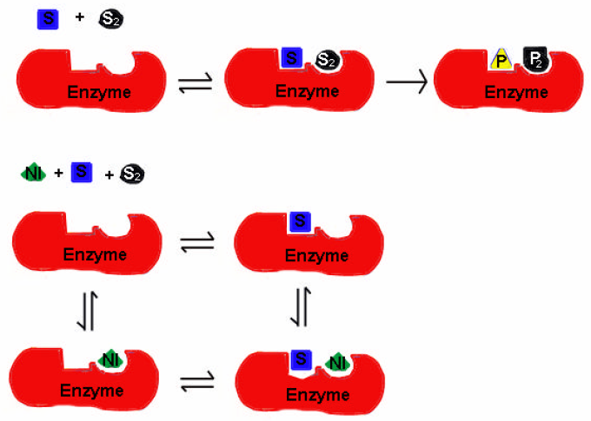
Mixed Inhibition

Slide 25
THANKYOU

