Slide 1
SN1 REACTION MECHANISM
Presented by,
ANJANA.T.M

Slide 2
Introduction
SN1 Reaction is a substitution reaction in organic chemistry.
"S_{N}" stands for "nucleophilic substitution", and the "1" says that the rate-determining step is unimolecular.
This relationship holds for situations where the amount of nucleophile is much greater than that of the intermediate.
The reaction involves a carbocation intermediate

Slide 3
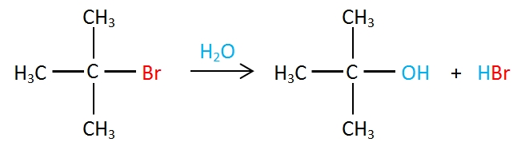
Mechanism
type of mechanism involves two steps. The first step is the reversible ionization of Alkyl halide in the presence of aqueous acetone or an aqueous ethyl alcohol. This step provides a carbocation as an intermediate.
The carbocation intermediate is formed in the reaction's rate determining step is an sp² hybridized carbon with trigonal planar molecular geometry.
An example of a reaction taking place with an S_{N}1 reaction mechanism is the hydrolysis of tert-butyl bromide with water forming tert-butanol:

Slide 4
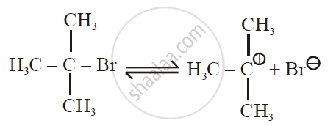
This S_{N}1 reaction takes place in three steps:
Formation of a tert-butyl carbocation by separation of a leaving group (a bromide anion) from the carbon atom: this step is slow and reversible.

Slide 5
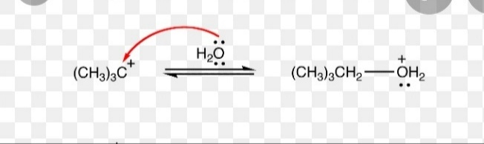
Nucleophilic attack: the carbocation reacts with the nucleophile. If the nucleophile is a neutral molecule (i.e. a solvent) a third step is required to complete the reaction. When the solvent is water, the intermediate is an oxonium ion. This reaction step is fast.

Slide 6
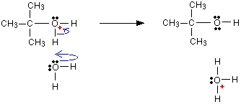
Deprotonation: Removal of a proton on the protonated nucleophile by water acting as a base forming the alcohol and a hydronium ion. This reaction step is fast.

Slide 7
Characteristics
The S_{N}1 mechanism tends to dominate when the central carbon atom is surrounded by bulky groups because such groups sterically hinder the S_{N}2 reaction.
Additionally, bulky substituents on the central carbon increase the rate of carbocation formation because of the relief of steric strain that occurs.
The resultant carbocation is also stabilized by both inductive stabilization and hyperconjugation from attached alkyl groups
The Hammond–Leffler postulate suggests that this too will increase the rate of carbocation formation.
The S_{N}1 mechanism therefore dominates in reactions at tertiary alkyl centers.

